Slide 1
Association of Colorado Independent Schools
Parent Association Leaders Workshop
November 30, 2022

Slide 2
Thank you to our Workshop Sponsor
ACIS Bronze Partner

Slide 3
Workshop Agenda
9:00 – 9:20 Welcome and Introductions
9:20 – 9:30 Intro to Independent School Governance and
Good Practice in PA/School Partnerships
9:30-10:10 Traits and Challenges of Good PAs
Why Bylaws Matter
Fundraising discussion
Keys to Effective Meetings and Decisions
PA’s role in DEIB discussions
10:10 – 10:20 Break
10:20-10:25 Words from our sponsor
10:25– 11:00 Case Studies
11:00 – 11:30 Interest Group Discussions
11:30-12:00 Lunch
12:00 – 12:45 School-Based Discussions
12:45 – 1:00 Wrap Up and Takeaways
Notes:
John

Slide 4
Welcome and Introductions
Housekeeping Items
School – to – School Introductions
Each school should pair with another. Share:
School Name
Location
Grades
Size (number of students)
Participant names
What is the most important reason you are here?
Share out
Notes:
John

Slide 5
What do your school leaders want you to know?
Community building is your most important role
Communication between school administration and PA leaders is critical
Clarity between role of the school and role of PA creates positive environments for each
You’ve been outstanding at supporting and appreciating our faculty and staff
We recognize COVID has required herculean efforts from PAs. Take some time to rethink and/or streamline
It’s hard to say “no” to individual parent ideas/pet projects. Let us help you help folks understand the cycle of the school year
We APPRECIATE you and are GRATEFUL for your partnership/collaboration. THANK YOU!!!
Notes:
John

Slide 6
What do your teachers want you to know?
Overwhelmingly, our teachers feel a tremendous amount of support and appreciation from ACIS PAs
Teachers report effective partnerships with Room Parents can really make a difference
They love it when you cheer them on!
Teachers are planners. They need understanding and advanced notice from PAs/Room Parents.
Differentiate your classroom approaches. Much like students who require different methodologies to learn best, teachers need different kinds of support. Have an open conversation with teachers to learn how best to support them.
Notes:
John

Slide 7
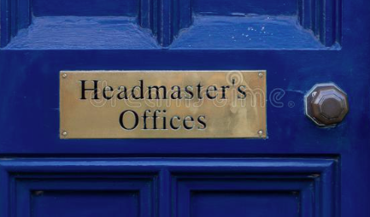
Introduction to Independent School Governance
Hold mission in trust for future generations
Fiduciary
Strategic
Head of School
Operations
Staffing
Program
Admission
Notes:
Alan

Slide 8
Introduction to Independent School Governance
The area of partnership is rarely black and white
Good Board/Head relationships will survive the rough spots
Notes:
Alan

Slide 9
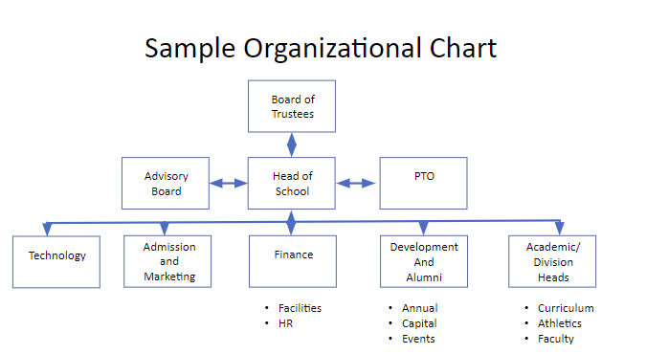
Notes:
Alan

Slide 10
The next 6 slides are text heavy. We’ll talk about:
Best practices
Common challenges
Why bylaws/organizing documents matter
To fundraise or not to fundraise
Keys to effective meetings and decision making
PA’s role in key school policies and/or hot topics

Slide 11
Best Practices for Successful Parent Associations
Vital and important support/service to school leadership and school community
Operate with a specific mission to support school and community
Have a written set of operating guidelines identifying roles and responsibilities
Are closely aligned with HOS/school administration
Have clear liaisons with the school
Have clearly delineated financial parameters and clarity around where funds are held and how they are allocated
Are inclusive of all parents
Are not one-size fits all; many successful models
Are careful not to overwhelm school staff/admin with requests or added duties
Notes:
John

Slide 12
Common Parent Association Challenges
Volunteer fatigue
Volunteer participation
Leadership succession
Clarity of role and responsibility
Relationship with school leadership
Communication
Fundraising stress
Change management
Notes:
John

Slide 13
Why Bylaws or Organizing Documents Matter
Provides clarity of purpose and roles/responsibilities
Provides for clarity of leadership succession process–admin should be involved; not for open nomination from the floor
Provides for clarity of fundraising purpose, communications, and control of funds
Provides clarity around the PA’s role in regards to parent complaints or concerns
Provides for clarity of the PA’s role vis a vis the board of trustees and school administration
Provides for clarity of processes for decision making and committee responsibilities
Helps avoid confusion down the road when new people step in.
Best practice is to FOLLOW your Bylaws or organizing documents.
Notes:
Alan

Slide 14
To fundraise or not to fundraise –that is the question!
Some schools want/need PA help with fundraising; some want them just to focus on community building. NO RIGHT ANSWER HERE.
If you do fundraise, close communication and coordination with the development office/HOS is critical
Any fundraising activities should be vetted with school admin first
The admin and/or board’s expressed desires for area of financial support should drive fundraising activities–not “pet projects” from PA members
Be careful of overasking of the community
Avoid leveraging students in these activities–i.e. class contests etc.
Develop a variety of ways parents can participate besides just big money
Notes:
Alan

Slide 15
Keys to effective meetings and decision making
Have a predetermined agenda with time frames for discussion by topic that has been vetted with administration
Reflect on the agenda if an action is required
Ensure that generative discussions are rooted in the PA’s mission and role, not related to other areas of school operations and/or governance
Establish at the beginning of the school year meeting protocols, PA mission and roles, responsibilities
If topics not on the agenda are raised, be willing to either clarify if appropriate or make note for future agendas; strive to avoid allowing the meeting to get hijacked
Notes:
John

Slide 16
PA’s role in key school policies and/or hot topics
PA leaders may be asked about your school’s DEIB efforts, COVID policies, dress code, disciplinary policies, etc. What do you do?
Again, this is where clear mission/bylaws can be very helpful.
Know the schools’ chain of communications and direct people accordingly.
Serving as PA leader requires being a public cheerleader for the school–even when your personal views might disagree.
Role is akin to being a trustee–if you can’t be publicly supportive and positive, you need to step out of a PA leadership role.
PA’s focus should be on community building. Policies, programs, and curriculum are the domain of the board of trustees/educators.
Know your hats and wear them appropriately–PA leader hat vs. individual parent hat.
Explain that the PA is not a court of arbitration between a parent(s) and the school.
Notes:
John

Slide 17
Case Studies in Parent Association Leadership
Case of maligned teachers
When homerooms are inequitable
Books and Bans

Slide 18
The Case of the Maligned Teachers
You are watching your school lose a basketball game or perform terribly on stage. Your child has often complained that the coach or drama teacher is “no good” and “mean.” Another parent makes a remark expressing doubt about the abilities of the coach or drama teacher. As parent association president, how do you respond in the moment? What are your next steps?
Notes:
John

Slide 19
The Case of the Inequitable Homerooms
Raymond Academy’s Parent Association assigns two room parents to each elementary homeroom. The representatives help teachers organize author celebrations, class parties, and decorate the classrooms for holidays, cultural celebrations, and other school events. In 1st grade, the room parents go all out with celebrations, holidays, and cultural events, decorating the classroom and helping the teacher prepare. The 2nd grade room parents don’t have the same “midas touch” as the 1st grade room parents. They are kind and helpful, but it is clear they decorate using a minimalist approach. Second grade students and families are upset. They don’t feel like they are getting the same attention as 1st grade and the feel like their students are suffering. There is disparity in other grades as well, but it’s most apparent in 1st and 2nd because the classrooms are next to each other. As PTO leaders, what do you do?
Notes:
John

Slide 20
Books and Bans
Over the course of the year, your elementary school invites children’s book authors to join the lower school via Zoom to talk about their books. On the slate are two authors who openly identify as, and use the term, “queer” in their bios; one is a trans female author and the other identifies as nonbinary.
A group of outraged parents approach the PA President and demand that the PA represent their position with the administration and/or board that these authors should be cancelled. What do you do and how do you respond?
A PA board member brings the topic up unannounced at a PA meeting and demands the same of the PA board. What do you do and how do you respond?
What if you personally are uncomfortable with these speakers? How does that influence your decisions as PA President? What are your options in terms of your personal misgivings?
Notes:
Alan

Slide 21
Lunch Discussions: An “Unconference” Experiment
An unconference is basically a conference without predefined topics. There is a high level structure and theme, but actual topics are generated by the participants on the spot, and breakout groups are formed dynamically based on interest and relevance.
Assumptions/Rules: Topics:
Lots of smart people in this room • Ideas to harness energy of the “new normal”
Take responsibility for your own learning • How to fully onboard new(er) parents to
Vote with your feet school community and culture
Two 15 minute sessions • Increase participation, volunteerism, and
One note-taker volunteer outreach - meeting the needs of
dual working families
• Fundraising ideas that support DEIB goals
Notes:
Alan

Slide 22
School-based Discussion Groups
Practice PA/PTO meeting structure.
Review PA/PTO mission statement.
Identify roles of PA/PTO as listed in protocol.
Is your PA/PTO fulfilling the roles as listed? If not, why? If so, how well?
Identify three specific takeaways/priorities from this workshop that you plan to implement at your school.
Determine how you will hold yourselves accountable for them.
Notes:
John

Slide 23
Key Takeaways
Align your PA with school leadership and mission.
Have PA leader meet with school leadership before each school year to identify goals and objectives
Maintain careful, consistent communication with HOS/Development office regarding fundraising activities
Clarify PA roles and responsibilities, especially “have tos/need tos” and “want tos/would like tos.”
Bylaws and/organizing documents matter. Review them regularly. The 1st Vice President to the Elementary School Volunteer Coordinator may not be necessary.
Think carefully about leadership succession, and outline a process in bylaws.
Serving in PA leadership involves being a positive ambassador for the school.
Know your “hats” and communicate accordingly.
Make clear to everyone that the PA is not a court of arbitration.
Develop and run efficient meetings with an agenda in advance (with input from school leadership). Watch out for “hijackers.”
In general:
PA should not be a separate 501(c3).
Trustees should not represent a voting block; they represent the school.
Notes:
Alan

Slide 24
Key Takeaways (continued)
Simplify. Just because it’s always been done doesn’t mean it has to be done.
Ask yourselves, if the PA did not exist would [insert example here] still happen?
Strive to avoid adding work/requests to the plates of teachers/staff/administrators/grounds crews.
Less done well is always better than more done poorly.
Build a Bigger Tent
Personally ask “likely” parents to participate.
Market your PA as essential to the school’s existence.
Consider a “feasibility-style” study, listen to learn.
Volunteerism and service comes in many ways; some volunteers do not want to be a part of PA structure/meetings.
Develop and advertise ways parents of all means can participate in and support PA fundraising and community-building events.
Appreciate and thank often.
Notes:
Alan

Slide 25
THANK YOU!!!
John Suitor
Head of School
Boulder Country Day School
President, ACIS Board of Directors
jsuitor@bouldercountryday.org
Alan Smiley
Executive Director, Association of Colorado Independent Schools
asmiley@acischools.org

