Slide 1
School Emergency Management Workshop 1
Brad Stiles, MA, Emergency Response Outreach Consultant
Colorado School Safety Resource Center
Colorado Department of Public Safety

Slide 2
Planning Principles
Engages the whole community.
Aligns school plans with other plans.
Must be supported by leadership.
Uses assessment information to customize plans.
Considers all threats and hazards.
Provides for the access and functional needs of the whole school community.
Considers all settings and all times.
Uses a collaborative process.
Notes:
Some key planning principles for developing a comprehensive school EOP are:
Must be supported by leadership. At the district and school levels, senior officials can help the planning process by demonstrating strong support for the planning team.
Uses assessment information to customize plans. Effective planning is built around comprehensive, ongoing assessment of the school community. Information gathered through assessments is used to customize plans to the building level, taking into consideration the school’s unique circumstances, resources, and community partners.
Considers all threats and hazards. The planning process must take into account a wide range of possible threats and hazards that may impact the school. Comprehensive school emergency management planning considers all threats and hazards throughout the planning process, addressing safety needs before, during, and after an incident.
Provides for the access and functional needs of the whole school community. School emergency management planning must address the needs of all students, staff, and visitors including those with disabilities and other access and functional needs.
Considers all settings and all times. School EOPs must account for incidents that may occur during and outside the school day, as well as at on- and off-campus events (e.g., sporting events, field trips, etc.).
Uses a collaborative process. Using the planning process in this course will provide the school with a process, plan format, and content guidance that is flexible enough for all school planning teams.

Slide 3
A Continuous Process
Planning is a continuous process of:
Gathering and analyzing information.
Conducting assessments.
Developing measures and plans.
Identifying resources.
Training and exercising.
Identifying lessons learned and making revisions.
Notes:
Planning is a continuous process. The process involves partners who can perform many different planning functions before, during, and after an incident, including:
Gathering and analyzing information.
Conducting hazard, threat, and vulnerability assessments.
Developing measures and plans to address hazards, threats, and vulnerabilities.
Identifying potential resources to support planning efforts.
Helping to train and exercise the plans.
Identifying lessons learned and making revisions to the school EOP and procedures.
Tell participants that the next visuals provide an overview of school planning considerations before, during, and after an incident.

Slide 4
Important Planning Considerations
Focus
Comprehensiveness
Currency
Appropriateness
Communication
Clarity and ease of use
Implementation
Notes:
Focus: Identify where you are vulnerable.
Comprehensiveness: Consider incidents before, during, and after typical operating hours.
Include off-site events, such as sports, field trips, and camps.
Be redundant. Don’t overly rely on a single approach. Identify backup personnel for key roles.
Currency: Base your plan on current information, and keep it current. If your building layout changes, update it in the school EOP. Update contact information regularly.
Appropriateness: Be sure your school EOP is age appropriate. There are significant differences in how elementary school children, high school students, and staff will behave in a crisis.
Be aware of the diverse needs of individuals, including those with disabilities or limited English proficiency.
Communication: Consider how you will communicate with staff, students, families, and the media during and after a crisis.
Clarity and Ease of Use: Use a format that is clear and easy to use. Include timelines, milestones, and responsibilities for completing them.
Implementation: Consider what training and exercising will be needed to make the school EOP effective.

Slide 5
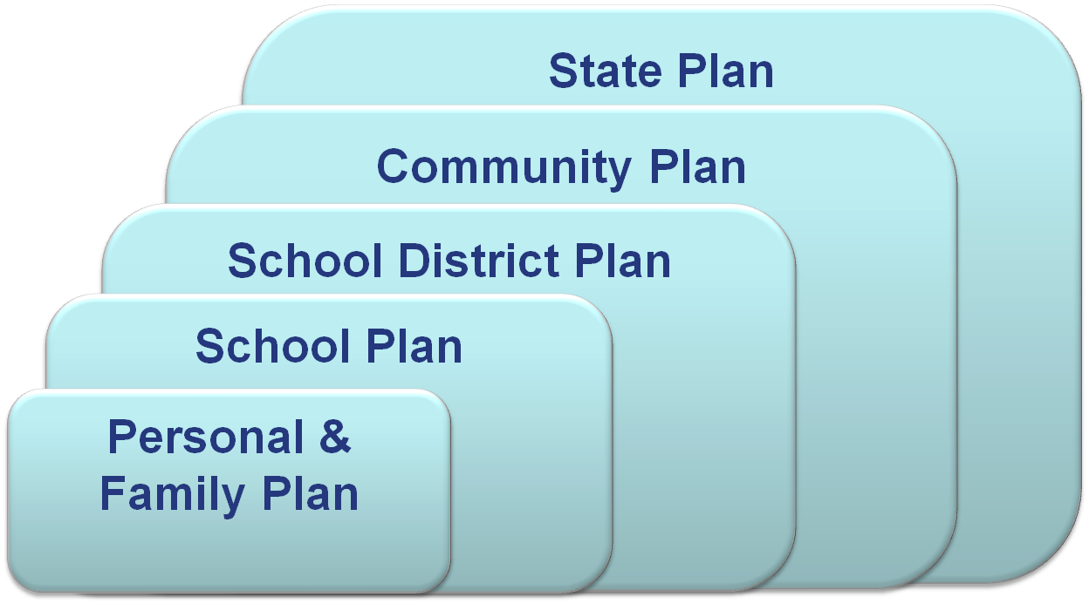
Alignment With Other Plans
Notes:
Schools undertake emergency operations planning within a spectrum that includes individual/family, district, community, State, tribal, regional, and Federal agency emergency planning. Otherwise known as NIMS, aligning with other plans will help you to become NIMS compliant.
Personal and family preparedness. It is important that school staff members have plans to ensure the safety of their families. Otherwise, the staff may not be able to focus on the needs of the school population when an incident occurs. In fact, some States have laws or mandates requiring personnel to remain at their school assignments during an emergency. Personal and family preparedness helps ensure that the staff members are ready to fulfill this obligation.
District liaison. School districts serve as the liaison between the school and these broader agencies. In order to promote coordination among these entities, the school is strongly encouraged to include district representation on the planning team. The local school district’s emergency planning policies, procedures, and training activities will inform and enhance the school’s planning to a significant degree.
Integration with community plans. It is critical that school EOPs are well integrated with school district and community plans, including being developed and exercised in close collaboration with them.
The school EOP should include a process for communicating with local emergency responders. Additionally, the school should participate in local preparedness programs and define a process to ensure the school EOP is incorporated into school district EOPs and the community plan.
State and regional plans. Community plans in turn should be developed and exercised in conjunction with State and regional plans. At the State level, EOPs should be designed to respond to citizens’ needs and to outline when to turn to the Federal Government for assistance.
Emergency use of the school. The school EOP should identify the use of the school facility in emergency situations, such as using the school for a shelter, reception area, staging area, point of emergency supply and food distribution, or alternate government facility. Schools need this information so they can address the issues in their planning.
Discussion Question: What are some of the important items that may be included in the local EOP to ensure proper integration with the school EOP?
Facilitate the discussion. If not mentioned, add that the local EOP should identify the priority of the school in the response protocols and the capability and timelines of such a response.
Refer to the emergency use of schools during a disaster.

Slide 6
Planning Process
Notes:
Today we will cover steps 2, 3 and part of step 4
While there are many ways to produce an EOP, this planning process has enough flexibility for each school to adapt it to its unique characteristics and situation.

Slide 7
A Thorough Plan
Notes:
Now that you understand the potential members of a planning team, the remainder of this unit focuses on the goal of a planning team—to develop and maintain a basic plan and annexes that address specific procedures, situations, or hazards.
The basic plan provides an overview of the school’s preparedness and response strategies. It describes all expected hazards, outlines roles and responsibilities, identifies a training plan and schedule, and explains how to keep the school EOP current.
Functional annexes are individual chapters that focus on procedures and missions, such as response and recovery procedures. These annexes describe the actions, roles, and responsibilities that participating organizations have for completing tasks for a function. They discuss how the school manages the function before, during, and after the emergency. In some plans, functional annexes are referred to as Emergency Support Functions (ESFs).
Threat-, hazard-, and incident-specific annexes focus on the special planning needs generated by a specific threat, hazard, or incident. They explain the procedures that are unique to that type of hazard . These annexes may be short or long, depending on the details needed to explain the actions, roles, and responsibilities. Strategies already outlined in a functional annex should not be repeated in a threat-, hazard-, or incident-specific annex.
Implementing instructions, which contain supporting documents such as a list of acronyms, copies of statutes, and maps, may also be included to provide additional guidance and references for planning.
These components form the school EOP that reflects school policy and legal obligations.

Slide 8
Understanding the Situation
Site Assessment
Culture and Climate Assessment
School Threat Assessment
Capacity Assessment

Slide 9
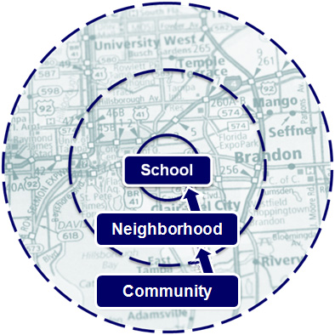
Identifying Threats and Hazards
Consider your:
Community.
Neighborhood.
School property and buildings.
Notes:
As your planning team identifies threats and hazards, they need to focus beyond just the school to the neighborhood and community.
Community: Weather or geological concerns, if the school is located in an area with extreme temperatures or weather patterns, near areas identified as at-risk using Hazards U.S. Multi-Hazard (HAZUS-MH) software analysis, and/or on a floodplain or earthquake fault line.
Neighborhood:
Are there natural threats and hazards near the school or on bus routes?
Does landscaping present a wind or fire hazard?
School property and buildings including both structural and nonstructural elements:
Structural elements: Threats and hazards may be created by damage to portions of the building whose primary function is to support the dead load. The local EOP for a community may include structural assessments for all government buildings in the community, including schools. Due to design or age, many school buildings present some kind of structural hazards. These structures include:
Modular classrooms
Unreinforced masonry:
Improperly supported roofs:
Nonstructural elements: Bookcases, office furniture, unsecured equipment, hazardous materials, etc…

Slide 10
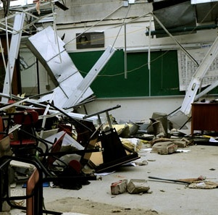
Natural Threats/Hazards
Include severe weather, floods, earthquakes, landslides, fire, and other events of nature.
Include biological threats such as animal disease outbreaks, pandemics, and epidemics.
May occur repeatedly.
Often can be predicted.
Notes:
Natural hazards are natural events that threaten lives, property, and other assets. Natural hazards tend to occur repeatedly in the same geographical locations because they are related to weather patterns or physical characteristics of an area. Often, natural hazards can be predicted.
Examples of natural threats/hazards include:
Severe weather, including:
Hurricane, lightning, tornado, severe wind, winter storm
Flood
Landslide/mudslide
Drought
Extreme temperatures
Earthquake
Tsunami
Volcanic eruption
Wildfire
Avalanche
Natural hazards also include biological threats such as:
Infectious disease pandemics and epidemics such as pandemic influenza, XDR tuberculosis, methicillin-resistant Staphylococcus aureus (MRSA), or meningitis infections.
Animal disease outbreaks—West Nile, Swine flu
Contaminated food problems including salmonella, botulism, and E. coli.
The process of identifying natural threats and hazards using your available resources will help you eliminate some of these from consideration.
Discussion Question: What is your school’s most significant natural hazard?
Facilitate the discussion and acknowledge the responses. List the hazards identified on chart paper. Save the list for use later in this unit.

Slide 11
Natural Threats/Hazards

Slide 12
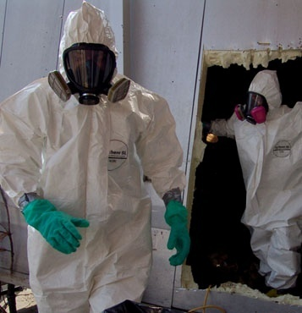
Technological Threats/Hazards
May be accidental or associated with another event.
Occur with little to no warning.
Include bus accidents, power failures, explosions, computer failures, and hazardous materials releases.
Notes:
Technological hazards involve materials created by man and that pose a unique hazard to the general public and environment. Consider incidents that are caused by accident (e.g., mechanical failure, human mistake), result from an emergency caused by another hazard (e.g., flood, storm), or are caused intentionally.
Technological hazards may be caused by accident, through another incident, or as a result of the failures of systems and structures. They may cause the loss of life or injury, property damage, social and economic disruption, or environmental degradation, and they often come with little to no warning. The effects can span many years.
When identifying technological hazards, the planning team considers neighborhood factors:
Commercial/industrial facilities: Are there utilities, gas stations, power lines, and/or industrial facility hazards in the neighborhoods around the school?
Transportation corridors: Is the school located near a highway or major road and/or close to a delivery route used by hazardous materials vehicles?
Examples of technological hazards include:
Airplane crash.
Communications and/or computer database failure.
Dam or levee failure.
Mine accident.
Hazardous materials release.
Power failure.
Radiological release.
Train derailment.
Bus accident.
Urban fire.
Examples of technological hazards that have affected schools include:
Power failure. A February 2008 power outage in Florida that affected 3 million people was attributed to human error. Two nuclear reactors were also affected by the blackouts and were shut down. More than 20 schools in two counties lost power.
Train derailment. In Painesville, OH, an October 2007 derailment of a 112-car freight train resulted in a massive fire. Several of the burning cars contained hazardous materials. A half-mile area around the derailment site was evacuated, including an elementary school with 340 students.
Hazardous materials release. On October 2, 2003, the Washington, DC, Fire Department Hazardous Materials Unit responded to an emergency call at Ballou High School to clean up a mercury spill. One student had obtained the mercury from a science lab and had sold some of it to other students. Traces of mercury were found in the classrooms, gymnasium, and cafeteria, as well as on city streets, city and school buses, and in 11 homes. As a result of the spill, Ballou High School was closed for 35 days and total cleanup costs were about $1,500,000.
Discussion Question: What technological hazard poses the most significant threat to your school?
Facilitate the discussion and acknowledge the responses. List the hazards identified on chart paper. Save the list for use later in this unit.

Slide 13
Technological Threats/Hazards

Slide 14
Human-Caused Threats/Hazards
Are deliberate actions taken to threaten or harm others.
Include school violence, bullying, armed intruder, chemical or biological attack, cyber attack, bomb threat, or other criminal actions.
Notes:
Human-caused hazards result from intentional human actions to threaten or harm the well-being of others, such as a threatened or actual chemical or biological attack, or cyber incident.
Potential threats that you may identify include:
An active shooter (see the information on targeted violence that follows).
Bullying, including cyber-bullying and sexting.
School violence, including gang violence.
Bomb or bomb threat.
Arson.
Hostage situation.
Domestic violence/abuse.
Suicide.
Cyber attack.
Drug-related emergencies.
Discussion Question: What human-caused hazard poses the most significant threat to your school?
Facilitate the discussion and acknowledge the responses. Mention that the school’s hazard analysis should include all of the hazards the school identifies as threats to their school. List the hazards identified on chart paper. Save the list for use later in this unit.
Encourage the participants to read the information on the next page on targeted violence and the impact of bullying. If active shooter and/or bullying were cited by the teams as key concerns, you may wish to review the information with the class.
Targeted Violence
When considering the threat of a mass casualty incident, it is important to understand that they come in many varieties and unfold in different ways. However, according to the findings of the Safe School Initiative (available at http://www.secretservice.gov and on the course toolkit), past incidents do share some common characteristics.
Common characteristics. Understanding common characteristics such as the following can help you understand and be ready in the unlikely event that an incident occurs at your site:
Incidents of targeted violence at school are rarely sudden, impulsive acts.
Prior to most incidents, other people knew about the attacker’s idea and/or plan to attack.
Most attackers did not threaten their targets directly prior to advancing the attack.
There is no accurate or useful “profile” of students who engage in targeted school violence.
Most attackers engaged in some behavior, prior to the incident, that caused others concern or indicated a need for help.
Most attackers were known to have difficulty coping with significant losses or personal failures. Many had considered or attempted suicide.
Many attackers felt bullied, persecuted, or injured by others prior to the attack.
Most attackers had access to and had used weapons prior to the attack.
In many cases, other students were involved in some capacity.
Impact of bullying. One of the common characteristics of attackers is that they had felt bullied, persecuted, or injured by others prior to the attack. This demonstrates the importance of addressing bullying and harassment in schools, as they can quickly escalate into school violence. Cyber-bullying and “sexting” have become popular methods for students to harass, humiliate, or intimidate one another using cell phones or computers. Students upload or send explicit messages, photos, or images via email, cell phone, or Internet-based social networking Web sites. Often, these messages or photos are disseminated over the Web well beyond their original intended recipients.
The social and legal implications of these student behaviors are far reaching. Victims of bullying, cyber-bullying, and sexting have lower self-esteem, increased thoughts of suicide, and a variety of emotional responses, which include fear, frustration, anger, and depression.
Cyber-bullying and sexting are more than unacceptable student behaviors; they are often the cause of school violence incidents.
To learn more about targeted violence and the impact of bullying, you may wish to take the FEMA course IS-360, Preparing for Mass Casualty Incidents: A Guide for Schools, Higher Education, and Houses of Worship

Slide 15
Human-Caused Threats/Hazards

Slide 16
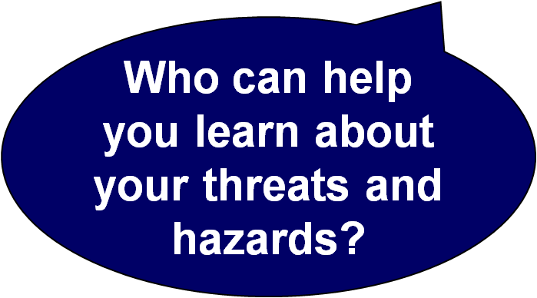
Gathering Information
Ask local experts.
Conduct research.
Review:
Existing plans.
Past threat and hazard assessments.
Past incidents.
Notes:
The first step in identifying threats and hazards is to determine who has information already available (for example, local emergency management or other community planners). Next, conduct research and analysis building on the information provided by the local experts. There are many resources available to help your planning team in gathering this information. It is important to understand that you do not need to “reinvent the wheel”—most of the information is already available.
Key point: Much research has been conducted on the natural threats and hazards by local emergency management, the community, and the school district.
To aid in threat and hazard identification efforts, schools should consider:
Asking local experts.
Planning team members can share their own knowledge of threats and hazards in the school and community.
Building code inspection and enforcement officers can share data on the structural integrity of buildings, codes in effect at time of construction, and the hazard effects that a code addresses.
Emergency managers and fire and law enforcement personnel can provide their expertise and additional insight during a systematic “walk around” of the inside and outside of the school.
Local planning and zoning commissions can offer extensive demographic, land use, building stock, and similar data.
Local realtors’ associations can often provide information on the numbers, types, and values of buildings.
Local public works departments and utilities can contribute information on potential damage to and restoration time for the critical infrastructures threatened by hazard effects.
Flood insurance representatives can determine if the school is in a flood hazard area.
Local organizations and community groups, such as the local chapter of the American Red Cross and the local Community Emergency Response Team, can provide helpful information.
Conducting research.
Local newspaper archives and historical society records can provide insight into past incidents and threats and hazards.
Internet research can yield information on historical and recent incidents and threats and hazards.
The chamber of commerce can offer a perspective on damage to businesses and general economic loss.
Local organizations (e.g., the local chapter of the American Red Cross) and members of the planning team can provide records about their experiences in previous disasters.
Reviewing existing plans, past threat and hazard assessments, and past incidents such as State mitigation plans and community emergency plans, community threat/hazard assessments, and information on incidents.
Your local emergency manager can help with local hazard mitigation plans and may direct you to the State or Tribal Hazard Mitigation Officer who guides the hazard mitigation planning process. These officers can provide schools with State, tribal, and local hazard mitigation plans, which identify, catalog, and assess the risk of all natural threats and hazards likely to affect the community.
Discussion Question: What people or resources are available in your community to help you learn more about your threats and hazards?
Facilitate the discussion and acknowledge the responses. Emphasize that members of the planning team should avoid limiting the number of sources and encourage long-time community residents to contribute to the process.

Slide 17
Information Sources
• State and local homeland security and emergency management laws, plans, policies, and procedures
• Existing EOP’s
• School climate surveys for students, faculty and staff
• Identified gaps in security policies and procedures
• Special considerations for individuals with language, access and functional needs
• Records from previous incidents, including historical data
• Local, regional, and neighboring community THIRAs

Slide 18
Information Sources
• Whole community partners, such as:
o Emergency management/homeland security agencies
o Local and state hazard mitigation offices
o Local or Regional National Weather Service offices
o Tribal governments
o Federal Emergency Management Agency (FEMA) Regional Offices
o Private-sector partners
o Local/state fire, police, emergency medical services, and health departments
o Volunteer Organizations Active in Disasters
o Colleges/universities, and other research organizations.

Slide 19
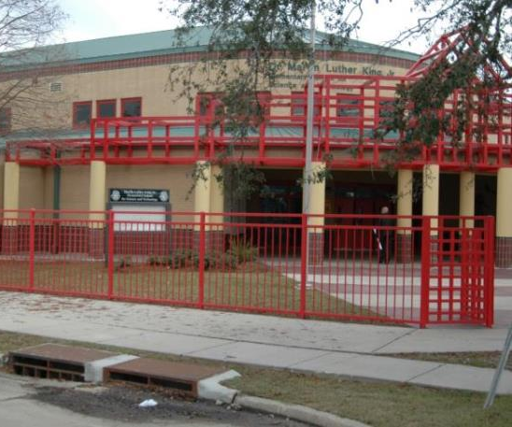
Assessment Areas
Neighborhood
Vehicle and parking areas
Outdoor recreation areas
Building exterior and interior
Entry and access control
Information and cyber security
Communications systems
Emergency procedures
Notes:
Be comprehensive. When conducting your assessments, make sure you address all areas. One way to do this is by working from the outside in.
Consider the surrounding neighborhood, street, walkways, and property perimeter.
Assess parking and drop-off areas, playgrounds, and other areas adjacent to the building.
Check the building exterior (including all doors and windows) and roof.
Check the building interior:
Start at front door and work inward.
Check hallways, classrooms, offices, open areas (auditoriums, gyms), food service areas, maintenance areas, and meeting room areas.
If the building has more than one level, have a plan to check all floors.
Use CPTED principles. As you conduct your walk-through, use the Crime Prevention Through Environmental Design (CPTED) principles to develop questions for each area. CPTED involves:
Natural surveillance: Ability to see what is occurring in a particular setting.
Natural access control: Ability to restrict who enters or exits an environment.
Territorial reinforcement: Ability to demonstrate ownership of and respect for property.
Management and maintenance: Ensuring building services function properly and safely, and exterior is properly maintained and organized with landscaping and plantings maintained and trimmed.
Using CPTED principles helps the team focus on how a physical environment can positively influence human behavior.

Slide 20
Some suggestions…
Do:
conduct a walk-through
consider perspective
use online tools
take photos or video
consider out-of-school events,
after school events and community events
survey bus routes
climate surveys
compare with previous assessments

Slide 21
Additional considerations…
Consider:
ingress/egress
identification process
landscaping
evacuation routes and sites
safe zones
communication systems
emergency supplies
threat assessment
training
supervision
hazardous materials
MOU’s
recovery
And, don’t forget to establish your priorities!

Slide 22
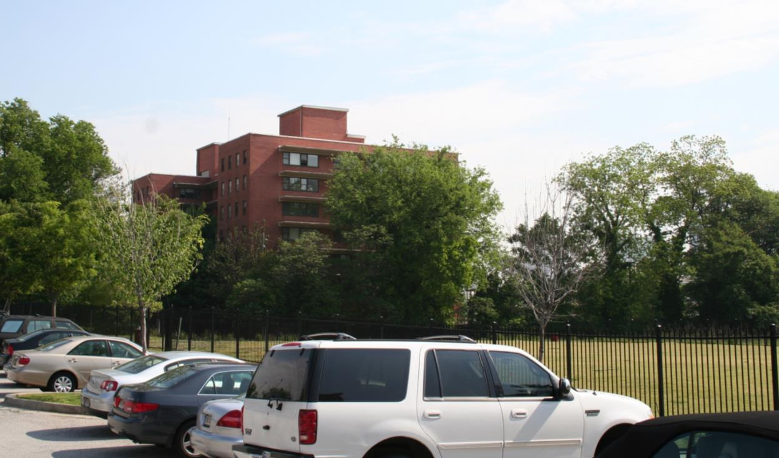
What Do You See?
Notes:
The next three visuals are intended to get the participants thinking about the importance of looking at the entire facility and campus with an eye on security.
Ask participants: What do you see? Is there anything that would help an assailant with either concealment or building access, or that would put people in greater danger? Next, think about the area outside your school—are there issues that should be addressed?
Acknowledge responses.
Your site assessment should include outdoor spaces that may affect security, such as:
Parking and traffic areas.
Outdoor activity areas such as playgrounds, athletic areas, courtyards, walkways, and other areas where students or staff could be at risk.
Landscaping and lighting.
Building surroundings.

Slide 23
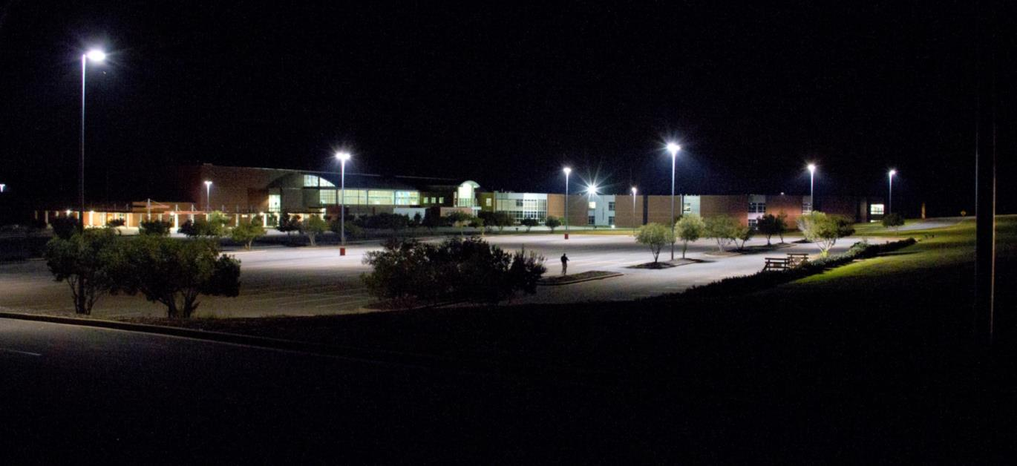
What Do You See?
Notes:
Ask participants: When you look at this photograph, what do you see?
Acknowledge responses. If not mentioned, suggest that some of the trees/bushes may make it possible to hide, that it is best to consider the effectiveness of lighting at night, and that some of the parking may not be reasonably illuminated.
Consider the photograph. What do you see that is positive? What are areas of concern?

Slide 24
Threat & Hazards List WoRksheet

Slide 25
Assessing/Prioritizing Threats/Hazards
Assess the threat or hazard by considering:
Probability.
Magnitude
Time (Warning/Duration).
Priority level.
Notes:
Once you have analyzed the threats and hazards, it is important to assess the associated risk in order to make risk-informed decisions about how to address the threats or hazards.
Assessing risk. Risk assessment helps a planning team decide:
What threats and hazards merit special attention.
What actions must be planned for.
What resources are likely to be needed.
There are several different types of assessments to consider when addressing the school environment. Each assessment process is most effective when it includes the appropriate school, first responder, and community partners.
A threat/hazard assessment evaluates threats/hazards in relation to their probability and severity. Many different aspects can be assessed: probability, magnitude, intensity/severity, warning time, location, size of affected area, speed of onset, duration, and cascading effects. Depending on the kinds of decisions and analyses the information is meant to support, planners will determine the necessary categories for data organization.
Organizing data. After natural, technological, and human-caused threats and hazards have been identified, the information should be consolidated into a format suitable for comparison. One method for organizing information is a table with the following types of information on each threat or hazard:
Probability or frequency of occurrence (i.e., how often it will occur).
Intensity/severity (i.e., the extent of expected damages).
Time available to warn staff, students, and visitors.
Duration (i.e., how long the hazard or threat will be occurring).
Follow-on effects.
Prioritizing. Once the planning team has organized the information on the potential threats and hazards, they will prioritize them. One option is to use a mathematical approach, which manipulates index numbers for different categories of information used in a ranking scheme. Using this approach, the planning team will categorize threats and hazards as high, medium, or low risk.
For the purpose of the following activity, we will focus on three main factors:
Probability—frequency of occurrence. This can range from a near 100 percent probability to less than 1 percent probability in the next year.
Intensity/severity—the impact or damage expected. Damage may range from catastrophic (hazard resulting in deaths and/or more than 50 percent of property severely damaged) to negligible (hazard resulting in minor injuries and/or less than 10 percent of property severely damaged).
Time—how fast the threat or hazard can impact the public. This time interval may be minimal, with little or no warning before the hazard occurs, or there may be more than 24 hours advance notice.

Slide 26
Probability
Highly likely: Near 100% probability in next year
Likely: Between 10-100% probability in next year or at least one chance in next 10 years
Possible: Between 1-10% probability in next year or at least one chance in next 100 years
Unlikely: Less than 1% probability in next 100 years

Slide 27
Magnitude
Severity | Characteristics
Catastrophic | Multiple deaths Complete shut down of critical facilities for 30 days or more More than 50% of property damaged
Critical | Injuries and/or illnesses result in permanent disability Complete shutdown of critical facilities for at least 2 weeks More than 25% of property is severely damaged
Limited | Injuries and/or illnesses do not result in permanent disability Complete shutdown of critical facilities for several days and up to 2 weeks More than 10% of property is severely damaged
Negligible | Injuries and/or illnesses are treatable with first aid Minimal quality of life lost Shutdown of critical facilities and services for 24 hrs. or less Less than 10% of property is severely damaged

Slide 28
Risk Assessment Worksheet
Risk Assessment Worksheet
Notes:
Rather than give you any absolutes when it comes to the scores you establish, let’s focus on the most severe. You can quantify this by analyzing those threats or hazards that have scored the highest, along with those threats or hazards that are important in your community, your parents and staff, may have already occurred in your schools’ history and/or you just have a “gut feeling” about. Once you have identified your most severe, pick the top three to work on today.

Slide 29
Goals
Goals should cover the desired outcome for each phase of an emergency before, during, and after and are also used to identify critical functions.
Before
During
After
Notes:
Goals need to be SMART:

Slide 30
Hazard: Fire
Hazard Goal Example 1 (before): Prevent a fire from occurring on school grounds.
Hazard Goal Example 2 (during): Protect all persons from injury and property from damage by the fire.
Hazard Goal Example 3 (after): Conduct recovery operations after a fire.

Slide 31
Objectives
Objectives are specific, measurable actions that are necessary to achieve the goals. Often, planners will need to identify multiple objectives in support of a single goal.
What
When
How

Slide 32
Hazard: Fire
Goal 1 (before): Prevent a fire from occurring on school grounds.
Objective 1.1: Provide fire prevention training to all students and staff who use combustible materials or equipment.
Objective 1.2: Store combustible materials in fireproof containers or rooms.

Slide 33
Hazard: Fire
Goal 2 (during): Protect all persons from injury and property from damage by the fire.
Objective 2.1: Evacuate all persons from the building immediately.
Objective 2.2: Account for all persons.

Slide 34
Hazard: Fire
Goal 3 (after): Conduct recovery operations after a fire.
Objective 3.1: Immediately notify fire department officials and EMS personnel of any fire on schools grounds via 911.
Objective 3.2: Immediately begin to provide first aid.

Slide 35
Threat & Hazard Goals and Objectives Worksheet
Using your 9 Goals from the last activity
Complete Pgs. 2-4 from Threat/Hazard Goals & Objectives Worksheet

Slide 36
Identify critical functions
Looking at the goals and objectives listed in the last section, you will find that certain critical “functions” or activities may apply to more than one threat or hazard.
Lockdown
Lockout (secure perimeter)
Evacuation
Shelter in place
Communications
COOP
Transportation
Security
Hold all Classes
Accountability
Reunification
Recovery
Medical
Training & Exercises
What are some common critical functions?
Notes:
Examples of these cross-cutting functions include evacuating, providing medical care, and accountability.
Lockdown, Lockout, Evacuation, Shelter-in-Place
Annotate on white board or chart paper

Slide 37
Critical Function: Evacuation
Function Goal Example 1 (before): Ensure all students and staff know their evacuation route.
Function Goal Example 2 (during): Evacuate the school immediately.
Function Goal Example 3 (after): Confirm that all individuals have left the building.

Slide 38
Critical Function: Evacuation
Goal 1 (before): Ensure all students and staff know their evacuation route.
Objective 1.1 (before): Assess, identify, and communicate the location of rally points to be used during an evacuation.

Slide 39
Critical Function: Evacuation
Goal 2 (during): Evacuate the school immediately
Objective 2.1: Evacuate all students, staff, and guests from the school using assigned routes.

Slide 40
Critical Function: Evacuation
Goal 3 (after): Confirm that all individuals have left the building.
Objective 3.1: Safely sweep the building.

Slide 41
Critical Functions Goals and Objectives Worksheet
Using your 9 Goals from the last activity
Complete Pgs. 2-4 from Threat/Hazard Goals & Objectives Worksheet

Slide 42
Step 1. Depict the scenario
Example:
Angry father arrives at the school and begins banging on the front door.

Slide 43
Step 2. Determine the amount of time available to respond
Example:
Zero to minimal time to respond, based on proximity to door.
May have a few minutes depending on the strength and/or construction of your school doors

Slide 44
Step 3. Identify decision points
Example:
Lockdown? Or Lockout?
He has a weapon

Slide 45
Step 4. Develop Courses of action
What is the action?
Example: Lockdown
Who is responsible for the action?
Example: Front Office staff initiate lockdown
When does the action take place?
Example: ASAP

Slide 46
Step 4 cont.,
How long does the action take and how much time is actually available?
Example: 1 minute, perhaps a few minutes
What has to happen before?
Example: Alert process
What happens after?
Example: All personnel lockdown in their assigned areas, law enforcement is notified and arrives on scene to manage the situation

Slide 47
Step 4 cont.,
What resources are needed to perform the action?
Example: Communication system, school personnel
How will this action affect specific populations, such as individuals with disabilities and others with access and functional needs who may require medication, wayfinding, evacuation assistance, or personal assistance services, or who may experience severe anxiety during traumatic events?
Example: Have medicine on hand in classrooms, specialized plan for communicating with ESL, provide for quiet area and activities for those with trauma

Slide 48
School Emergency Management Workshop 2
Brad Stiles, MA, Emergency Response Outreach Consultant
Colorado School Safety Resource Center
Colorado Department of Public Safety

Slide 49
Basic Plan: Overview
The basic plan:
Provides an overview of the school’s approach before, during, and after an incident.
Addresses overarching activities.
Has a primary audience of the school, local emergency officials, and community.
Notes:
The school EOP consists of three components: basic plan, functional annexes, and threat/hazard/incident-specific annexes
The basic plan:
Provides an overview of the school’s approach to operations before, during, and after an incident.
Addresses the overarching activities the school undertakes regardless of the threat or hazard.
Has a primary audience of the school, local emergency officials, and the community (as appropriate).
Functional annexes detail goals, objectives, and courses of action for functions that apply across threats and hazards.
Threat/hazard/incident-specific annexes detail goals, objectives, and courses of action for a particular threat, hazard, or incident type.
Key point: The basic plan is a vital component of a school’s EOP. Through a thoughtfully developed basic plan, a school will be able to gain an understanding of threats/hazards that might be faced, use agreed upon terminology, and have clarity in roles and responsibilities.
If you will be using the sample school EOP in this course, ask students to get it out. Explain that the plan is an example to assist them in the review of their school EOP.

Slide 50
Writing and Organization Strategies
Keep language simple and clear.
Provide appropriate detail.
Create procedural documents to summarize important information.
Develop accessible tools.
Ensure that your school EOP is:
Organized, sequenced correctly, consistent, adaptable and compatible.
Notes:
Plans must also be written to be user-friendly. School administrators and staff are more likely to use a plan when information is logically organized and easy to read. When writing the school EOP:
Keep the language simple and clear:
Write in plain English.
Avoid jargon and minimize the use of acronyms.
Use short sentences and the active voice.
Provide detail that is appropriate to the target audience and the likelihood of the situation. Provide guidance for carrying out common tasks as well as enough insight into intent and vision so that responders can handle unexpected events. Plans written for schools with high staff turnover may require additional detail.
Create procedural documents to summarize important information and provide the fine detail for staff. Examples of procedural documents include small maps, flowcharts, or checklists of procedures developed specifically for teachers to use during an incident.
Develop accessible tools and documents. Use appropriate auxiliary aids and services necessary for effective communication, such as accessible Web sites, digital text that can be converted to audio or braille, text equivalents for images, and captioning of any audio and audio description of any video content.
Ensure that the school EOP is:
Organized.
Can users find what they need?
Is all the information relevant?
Is the plan formatted clearly?
Is its content presented clearly?
Sequenced correctly.
Can users understand the rationale for the sequencing?
Are users able to scan for information they need?
Consistent.
Does each section use the same logical progression, or do users have to reorient themselves?
Adaptable and compatible.
Is the information easy to use during unanticipated situations?
Can the information be applied or adapted to effectively respond to each unique situation?
Does the format promote or hinder coordination with local response agencies and personnel?

Slide 51
Cover Page Worksheet
Notes:
The cover page includes the title of the plan, a date, and the school(s) covered by the plan.

Slide 52
Promulgation Signature Worksheet
Notes:
This document or page contains a signed statement formally recognizing and adopting the school EOP. It gives both the authority and the responsibility to school officials to perform their tasks before, during, or after an incident, and therefore should be signed by the school administrator or another authorizing official.

Slide 53
Approval and Implementation Worksheet
Notes:
This page introduces the plan, outlines its applicability, and indicates that it supersedes all previous plans. It includes a delegation of authority for specific modifications that can be made to the plan and by whom they can be made without the school administrator’s signature. It also includes a date and should be signed by the authorized school administrator.

Slide 54
Record of Changes Worksheet
Notes:
Record of changes. The school must first determine who has the authority to authorize or make changes in the plan.
Each update or change to the plan should be tracked. The record of changes, usually in table format, contains at a minimum:
A change number.
The date of the change.
The name of the person who made the change.

Slide 55
Record of Distribution Worksheet
Notes:
Record of distribution. The record of distribution, usually in table format, indicates:
The title and name of the person receiving the plan.
The agency to which the receiver belongs.
The date of delivery.
The number of copies delivered.
The record of distribution can be used as proof that tasked individuals and organizations have acknowledged their receipt, review, and/or acceptance of the plan. Copies of the plan can be made available to the public and media without including sensitive information.

Slide 56
Table of Contents Worksheet
Notes:
Table of Contents. The table of contents is a logically ordered, clearly identified layout of the major sections and subsections of the plan that will make finding information within the plan easier.

Slide 57
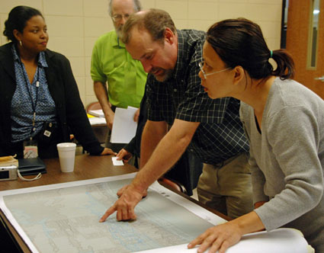
Purpose, Scope, Situation, Assumptions
Provides a rationale for the development, maintenance, and implementation of the school EOP.
Includes:
Plan purpose.
Plan scope.
Situation overview.
Planning assumptions.
Notes:
The Purpose, Scope, Situation Overview, and Assumptions section of the basic plan provides a rationale for the development, maintenance, and implementation of the school EOP. This section should include:
Note: The level of detail to include in Purpose, Scope, Situation Overview, and Assumptions is a matter of judgment. Schools may wish to include additional overview or introductory information in the functional or threat/hazard/incident-specific annexes. Maps such as basic school floor plans and site maps should be included as appendixes to support the situation description and correctly outline the geographical areas of the school.

Slide 58
Purpose Worksheet
Notes:
Purpose: Sets the foundation for the rest of the school EOP. The Purpose is a general statement of what the EOP is meant to do. The statement should be supported by a brief synopsis of the basic plan, the functional annexes, and the threat/hazard-specific annexes.

Slide 59
Scope Worksheet
Notes:
Scope: Outlines the scope of the school’s emergency and disaster response (at what times or under what conditions this plan would be activated). Specifically, the scope includes:
A brief description of the school’s response to incidents.
The entities (staff, superintendent, local government, etc.) with roles and responsibilities outlined in the plan.
The geographic areas covered in the plan, specifically school buildings and grounds.

Slide 60
Situation Overview Worksheet
Notes:
Situation Overview: Explains why an EOP is necessary. At a minimum, the situation section should summarize threats/hazards and vulnerabilities faced by the school. The Situation Overview covers:
The geographical and political jurisdiction of the school.
A brief synopsis of local hazards and past incidents.
A summary of potential, wide-reaching threats to the school community, such as pandemic flu.
Relative probability and impact of the threats and hazards.
Geographic areas likely to be affected by particular threats or hazards.
School population including those with access and functional needs.
Dependencies on parties outside the school for critical resources.
The school’s capabilities and limits for preparing for and responding to the defined hazards.

Slide 61
Planning Assumptions and Limitations Worksheet
Notes:
Assumptions: Identify what the core planning team assumed to be facts for planning purposes.
Obvious assumptions should be included but limited to those that need to be explicitly stated (e.g., do not state as an assumption that the hazard will occur; it is reasonable for the reader to believe that if the hazard was not possible, the plan would not address it).

Slide 62
Concept of Operations Worksheet
Notes:
The CONOPS describes how the school will protect students, staff, and visitors and should indicate:
Who has authority to activate the school EOP (e.g., emergency management agency office, chief elected official, State official, fire/police chief).
The process of school coordination with other agencies.
How the school EOP takes into account those with disabilities and other access and functional needs.
Other emergency plans that support the school EOP (e.g., hospital plans, facility plans).
The purpose of:
Activities before an emergency to protect and mitigate the impact on life and property.
Action taken during an emergency to respond effectively.
Action taken after an emergency to recover.
The sequence of action, including:
The process, templates, and individuals involved in issuing a declaration of emergency for a given hazard and how the declaration will be coordinated with neighboring jurisdictions and the State.
Activation of operations centers.
“Action levels” and their implications (if formalized in the jurisdiction).
Other response/support agency plans that directly support the implementation of this plan (e.g., hospital plans, facility plans).
How requests for resources will be met, and by whom and under what circumstances will requests be made for additional aid from the State (this should include the process for declaring a state of emergency; any necessary forms should be contained in tabs).
An overview of direction and control, alert and warning, continuity of operations (COOP) matters, or other activities that may be dealt with more fully in annexes.

Slide 63
Purpose, Scope, Situation, Assumptions
Provides a rationale for the development, maintenance, and implementation of the school EOP.
Includes:
Plan purpose.
Plan scope.
Situation overview.
Planning assumptions.
Notes:
The Purpose, Scope, Situation Overview, and Assumptions section of the basic plan provides a rationale for the development, maintenance, and implementation of the school EOP. This section should include:
Note: The level of detail to include in Purpose, Scope, Situation Overview, and Assumptions is a matter of judgment. Schools may wish to include additional overview or introductory information in the functional or threat/hazard/incident-specific annexes. Maps such as basic school floor plans and site maps should be included as appendixes to support the situation description and correctly outline the geographical areas of the school.

Slide 64
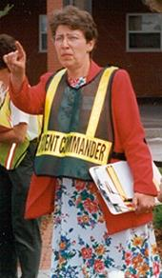
Key Roles and Responsibilities
Preparedness and planning roles
Incident management roles
Senior Executive/Policy and Multiagency Group
Incident Commander
Public Information Officer
Liaison Officer
Safety Officer
Section Chiefs: Planning, Operations, Logistics, Finance and Administration
Notes:
Key roles and responsibilities defined in Organization and Assignment of Responsibilities include:
Preparedness roles. You may want to identify roles and responsibilities as they relate to activities before an incident. In doing so, remember that the primary purpose of the school EOP is to focus on incident management.
Planning roles. Examples include:
Intelligence/Information Gatherer: Conduct threat analysis and monitor the situation.
Policy Maker: Develop policies and procedures to reduce threats/risks.
Planner: Develop and maintain the school EOP.
Marketer/Communicator: Sell the concepts of planning and preparedness on an ongoing basis.
Trainer: Develop and implement training and exercises.
Finance Officer: Identify the cost/benefit of implementing preparedness measures.
Evaluator: Identify best practices and lessons learned.
Incident management roles. Incident management (response and recovery) roles are filled based on the event or incident and which organization has the authority and expertise to management the incident. Therefore, incident management positions may be filled with school personnel and/or first responders.
The school EOP should define the incident management roles so that they may be filled internally or, if the situation warrants, by first responders and law enforcement personnel. Key roles are described on the next page.
Senior Executive (Superintendent, Principal, Emergency Manager, Elected Official, etc.): Provides policy guidance on priorities and objectives based on situational needs and the school EOP. Oversees resource coordination and support to the Incident Commander.
In complex incidents, a policy group or multiagency coordination group may convene to:
Establish priorities for incidents.
Identify and resolve issues common to all groups responding to the incident.
Develop procedures to implement decisions.
Keep elected officials and other executives informed of the situation and decisions.
Inform response partners of decisions.
Provide factual information, both internally and externally.
Incident Commander: Sets the incident objectives, strategies, and priorities and has overall responsibility for the incident.
Public Information Officer: Serves as the conduit for information to internal and external stakeholders, including the media or other organizations seeking information directly from the incident or event.
Liaison Officer: Serves as the primary contact for supporting agencies assisting at an incident.
Safety Officer: Monitors safety conditions and develops measures for assuring the safety of all assigned personnel.
Operations Section Chief: Establishes the tactics to meet the incident objectives and directs all operational resources.
Planning Section Chief: Supports the incident action planning process by tracking resources, collecting/analyzing information, and maintaining documentation.
Logistics Section Chief: Provides resources and needed services to support the achievement of the incident objectives.
Finance and Administration Section Chief: Monitors costs related to the incident. Provides accounting, procurement, time recording, and cost analyses.
The roles and responsibilities listed above parallel those outlined in NIMS. Aligning roles with NIMS allows for better coordination with first responders, law enforcement, and emergency managers.

Slide 66
Organization and Assignment of Responsibilities Worksheet
Notes:
In review: This section provides an overview of the broad roles and responsibilities of school staff, families, guardians, and community partners (e.g., first responders, local emergency managers, public and mental health personnel), and of organizational functions during all emergencies. It
Teachers will be responsible for the supervision of students and shall remain with students until directed otherwise. Teachers’ responsibilities include:
directing students to inside or outside assembly areas according to instructions provided by the Incident Commander or designee;
accounting for students when class relocates to an outside or inside assembly area or evacuates to another location;
reporting missing students to the Incident Commander or designee;
obtaining first-aid services for injured students; and if trained and certified in first aid, rendering first aid, if necessary.

Slide 67
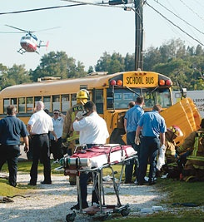
Incident Coordination
Incident coordination should:
Include the principal and other core positions.
Use staff/faculty titles rather than individual names.
Name specific organizations or agencies responsible for providing additional resources or assistance.
Notes:
Coordination between schools and law enforcement, fire, and emergency managers is essential.
Incident coordination allows schools and first responders to successfully respond to an incident together by outlining how efforts will be coordinated across jurisdictions while allowing each jurisdiction to retain its own authority.
Incident coordination should:
Include the school principal, building administrator, and other core positions within the school or school district.
List staff/faculty job titles or qualifications, rather than individual names, to fill key roles. Specific individuals may be absent, injured, or otherwise unable to perform assigned responsibilities.
Name the specific organizations or agencies responsible for providing additional resources or assistance.

Slide 68
Direction, control and coordination Worksheet

Slide 69
Information Collection, Analysis and Dissemenation Worksheet

Slide 70
Training & Exercises Worksheet

Slide 71
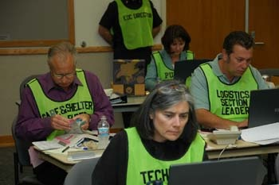
Administration, Finance & Logistics
Covers:
General support requirements.
The availability of services and support.
Policies for managing resources and recordkeeping.
Notes:
This part of the basic plan covers policy related to the following:
Administration: Describes administrative protocols used during an emergency operation, including documentation of the actions taken during and after the incident (e.g., incident and damage assessment, incident command logs, cost recovery) and completion of an after-action report to identify strengths and weaknesses in the emergency management and response program.
Finance: Describes protocols used to document and recover the costs incurred during an emergency operation. This section may also describe the various programs that allow local political jurisdictions, response/support agencies, or the general public to recover their costs (e.g., Small Business Administration (SBA), Public Assistance Program, unemployment, worker’s compensation) and the impact and role that insurance has in recovering costs (e.g., self-insured, participation in the National Flood Insurance Program (NFIP), homeowner policies).
Logistics: Describes mechanisms used to identify, acquire, and manage resources before and during an emergency operation. It provides a brief summary statement about specialized equipment, facilities, personnel, and emergency response organizations currently available to respond to the defined threats/hazards. This section also identifies any existing memorandums of agreement or understanding and contingency contracts with organizations to supply needed resources.
To support the Logistics element, the school should maintain (e.g., in an appendix to the school EOP or as a separate document) a list of the types of resources available, amounts on hand, locations maintained, and any restrictions on use.

Slide 72
Administration, Finance & Logistics Worksheet

Slide 73
Plan Development and Maintenance Worksheet

Slide 74
Authorities and References Worksheet

Slide 75
Functional Annexes
Address response and recovery procedures.
Describe the actions, policies, roles, responsibilities, and processes for each function.
Discuss how the school manages each function before, during, and after an incident.
Notes:
An important planning task is to identify the functions that are critical to successful emergency response. These core functions become the subjects of the separate functional annexes.
Functional annexes:
Address all-threat/hazard critical operational functions, including:
Response procedures.
Recovery and continuity of operations (COOP) procedures.
Other broad functions such as communications and security.
Describe the actions, policies, roles, responsibilities, and processes for each function.
Discuss how the school manages each function before, during, and after an incident.
Functional annexes recommended in Guide for Developing High-Quality School Emergency Operations Plans are listed below. (Note: This is not a complete list, but it is recommended that all school EOPs include at least the following functional annexes.)
Communications
Evacuation
Shelter-in-Place
Lockdown
Accounting for All Persons
Reunification
Continuity of Operations
Security
Recovery
Health and Medical
While these functions should be described separately, it is important to remember that many functions will occur consecutively. For example, sheltering-in-place during an earthquake may be implemented, but if the building is damaged the school may then initiate an evacuation.
Functions may also be performed concurrently. During an evacuation, for example, as students and staff are safely out of the building the accounting function begins, while evacuation may still be occurring in other parts of the school.

Slide 76
Response Functional Annexes
Evacuation
Shelter-in-Place
Lockdown/Lockout
Accounting for All Persons
Reunification
Health and Medical
Notes:
Response procedures (also called protocols or response actions) are standardized, specific actions for school staff and students to take for a variety of threats, hazards, or incidents. By developing and practicing a set of response procedures, school staff and students will be able to quickly and safely respond in a variety of situations.
Examples of response procedures that should be detailed in functional annexes are listed on the visual. The following table describes these procedures and planning considerations for each.
All functional annexes should address:
Situations under which the procedures should be used.
Who has the authority to activate the procedures.
Specific actions to be taken when the procedures are implemented.
Review the information on each procedure on the following page before going to the next visual.

Slide 77
Considerations
Off-campus events
Access and functional needs
Mass casualties
Student release
Supplies
Notes:
When developing your response procedures, in addition to the steps that need to be taken to carry out the procedure, you need to think about how you will address different situations. For example:
What if an incident occurs at an off-campus event?
How will you address students and staff with disabilities or other access and functional needs?
How will you handle an incident with many injuries?
How will you safely release students?
What supplies will you need?
As you review the considerations, ask participants what they would add.

Slide 78
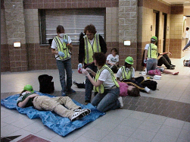
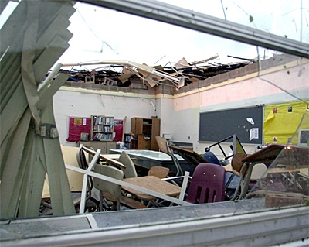
Response Priorities
Determine response priorities based on:
Life safety concerns.
Incident stabilization.
Property protection.
Notes:
Protecting the health and safety of everyone in the facility is the first priority during an emergency.
Schools should outline procedures related to evacuation routes (primary and secondary) and exits. Designate the appropriate assembly areas and establish procedures for student and staff accountability. Describe procedures related to seeking shelter during an incident (e.g., severe weather or earthquake).
A second priority is incident stabilization.
When an incident occurs, incident stabilization activities (e.g., firefighting, damage assessment, property conservation) are a priority for the emergency responders.
A third priority is the protection of school property.
Protecting facilities, equipment, and vital records is essential to restoring operations once an emergency has occurred. Establish procedures for:
Fighting fires.
Containing material spills.
Closing or barricading doors and windows.
Shutting down equipment.
Covering or securing equipment.
Moving equipment to a safe location.
Addressing active shooter incidents and managing mass casualties.

Slide 79
Academic Recovery
Identify who can open/close the school.
Identify temporary sites.
Identify strategies to:
Continue teaching.
Communicate with parents/guardians.
Reevaluate the curriculum.
Notes:
In developing your academic recovery procedures:
Identify who will be responsible for making the decision to close/open schools, or send students/staff to alternate locations. Identify ways to convey that information to parents/guardians, students, and school staff and officials.
Identify possible temporary sites for classrooms and administrative operations. Consider locations for both short-term and longer term operations, and the decisionmaking process for selecting a location.
Identify strategies to continue teaching. Examples include:
Mailing lessons to students.
Using telecommunications (e.g., local television or radio stations, text messages, emails, Web portals).
Providing tutors for homebound students.
Rearranging the syllabus or tests until needed facilities are available.
For example, after Hurricane Katrina high school students displaced by the hurricane were eligible for free, teacher-led online courses.
Consider also ways to meet additional staffing needs in case personnel are unable to perform their responsibilities.
Communicate with parents/guardians regarding changes to schedules, updates on classroom locations, and information on the status of the school building. Keeping parents and guardians informed is critical to maintaining their support. As an added benefit, being proactive and releasing information about the school’s recovery can help offset any negative perceptions created by the incident or the response.
Reevaluate the curriculum and determine what topics can be delayed or discarded. Contact the State department of education to see what flexibility may be available to local school districts.
Discussion Question: How will you quickly establish structure and restore routine for students and staff?
Facilitate the discussion. Acknowledge the responses. If not mentioned by the participants, note that establishing structure and restoring routine will depend on the availability of alternate classroom space, school district policy, the condition and needs of the surrounding community, and the requirements of State law.

Slide 80
Physical Recovery
How will you:
Document school assets?
Access school records?
Coordinate with utility and insurance companies?
Resume transportation and food services?
Obtain classroom equipment, books, and materials?
Restore school buildings and grounds?
Notes:
In developing your functional annex for physical recovery, consider how you will:
Document school assets and records in case of damage, including which personnel have expert knowledge of school assets and how and where they will access records to verify current assets after disaster strikes.
Coordinate with utility and insurance companies before an emergency to support a quicker recovery.
Resume transportation and food services. Consider how students will get to the school if an important road is damaged in an incident.
Obtain classroom equipment, books, and materials in advance of relocating, either to a new temporary or permanent location or back to a former, restored location.
Restore buildings and grounds (e.g., debris removal, repairing, repainting, and/or re-landscaping).

Slide 81
Fiscal Recovery
Identify how you will:
Execute contracts rapidly.
Issue return-to-work notifications.
Register students.
Keep redundant records.
Restore business functions.
Identify resources for emergency relief funding.
Manage donations.
Notes:
Point out that many of the fiscal recovery issues may be included in a Continuity of Operations annex or plan, which will be discussed later in the unit.
In developing your functional annex for fiscal recovery:
Ensure systems are in place for rapid contract execution after an incident. The period after a school building has been destroyed by a tornado is not the ideal time to start negotiating contracts on temporary building space.
Create a notification system that will inform staff on the specifics of returning to work.
Create a system for registering students (out of district or into alternative schools). Displaced students may be missing immunization records, proof of residency, or cumulative folders and permanent school records. If a nearby school district is able to reopen their schools sooner, parents/guardians may want to enroll their children in that district.
Ensure you have redundant records kept at a different physical location. Be sure to include a copy of the school’s insurance policy and keep the policy current.
Identify a line of succession to restore business functions, including administrative and recordkeeping functions such as payroll, accounting, and personal records.
Identify resources the school may access for emergency relief funding. Work with the community and local and State government to identify possibilities.
Identify how donations will be managed. When disasters happen, the public often wants to provide donations to the school to show support. It is important to have a plan for what can be accepted and how donations will be managed.
Example: Newtown, CT, officials were overwhelmed by the donations of gifts sent after the Sandy Hook school shooting tragedy. Newtown received tens of thousands of toys, artwork, and school supplies. The town offered donation guidance to the public including:
Contacting the receiving organization prior to donating.
Not sending perishable items.
Being patient because items require inspection.
Asking national organizations to register with the town.
Source: http://www.usatoday.com/story/news/nation/2012/12/26/newtown-sandy-hook-school-shooting-halt-gifts/1792553/
Discussion Question: How will you protect and recover critical school, human resource, and financial records?
Facilitate the discussion. Acknowledge the responses. If not mentioned by the participants, note that the best method to protect critical records is to store duplicate records (both electronic and paper copies) offsite. The school district may have a policy and process for protecting records.

Slide 82
Communications Annex
Address communication before, during, and after an emergency, including:
Integration with response network
Equipment operation and compatibility
Communication within the school and with the community
Addressing language, functional needs, and technology barriers
Interaction with the media & rumor control
Notes:
Remind the participants of the difference between the Communications section of the basic plan (as described in Unit 4) and the Communications functional annex.
The Communications section of the basic plan describes the overall framework for internal and external communications during an emergency. It does not describe communications hardware or specific procedures; these are included in the Communications functional annex.
The communications functional annex addresses:
Communication of emergency protocols before an emergency.
Communication and coordination during emergencies (both internal communication and communications with external stakeholders).
Communication after an emergency.
Review the following considerations for the communications functional annex.
When developing the communications functional annex, consider:
How the school’s communications system integrates into the local disaster response communications network (e.g., fire, law enforcement). Routine and frequent communication with external response agencies is essential throughout the process. This element of the functional annex should include procedures that have been developed in advance with responders for:
Transferring command. Procedures should be established to facilitate the transfer of command between the school and first responders. For example, in the case of an intruder or hostage situation, the initial Incident Commander may transfer command upon the arrival of an Incident Commander from the authorized law enforcement agency. When the situation is resolved, the law enforcement Incident Commander may transfer command to a school Incident Commander to oversee the reunification process and provision of crisis counseling.
Ensuring interoperable communications. It is critical to ensure that schools and emergency management/response personnel are able to communicate within and across agencies via voice, data, or other systems when needed, and when authorized.
How to ensure relevant staff members can operate communications equipment and that the equipment works. Any communication system used, whether two-way radios, cell phones, or other equipment, must be capable of operation between the school administrative office, the sending location, and the parent-student reunification site (if applicable), as well as within transit to and from any of those locations. It is also important to ensure that the communication system used by your local responders will work in all parts of your building and outside.
If radios are used, they must be compatible with any school bus radio system. If cell phones are used, the school will need to maintain a list of bus driver cell phones to be used in case of emergencies.
How the school will communicate with students, families, and the broader community before, during, and after an emergency.
Before an incident, schools should strive to accomplish this goal by creating:
Outreach tools to explain the school’s EOP and procedures (including tools for people who have hearing or visual impairments, and non-English-speaking parents).
Partnerships with qualified parent volunteers to assist during incidents.
Templates and procedures for disseminating information to parents/guardians (e.g., text messages, television, radio, phone). Parents and guardians need to be made aware of their responsibilities and procedures to follow, such as family reunification, during an emergency.
During an incident, schools will be expected to communicate critical information to families. Schools should:
Activate established communication systems to describe what is known about an incident and how the school is handling it.
Provide instructions and/or additional details as they become available using predetermined communication tools.
Following an incident, the school may wish to conduct a question-and-answer session for parents/guardians. Such a session can be an opportunity for schools to discuss lessons learned as well as next steps.
How to account for potential language and technology barriers faced by students, staff, parents, and guardians.
How the school will handle the media (e.g., district or school public information officer). This may include developing templates for statements to the media, including:
Standard procedures and protocols.
Contact information/hotline for more information.
How impacts on students will be communicated to the community, including the impact on activities related to the school but not necessarily at the school or during school hours.
How the school will curb rumors. Rumors inevitability arise during emergencies. When accurate information is not available, rumors begin, and without facts people will speculate. Rumors can create a negative perception of the school’s ability to manage the incident. Administrators, teachers, students, custodians, secretaries, teaching assistants, cafeteria workers, and bus drivers are primary sources of information and are likely to be contacted by the media and community members. An internal communication strategy should be developed and include several ways to convey information to staff members.
How the school will ensure effective communication with individuals with access and functional needs. This may include coordinating with responders and local emergency managers to provide sign language interpreters for use during press conferences, publishing accessible documents, and ensuring that the school Web site is accessible.

Slide 83
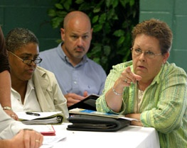
Internal Communication
Describe methods for keeping staff informed.
Identify actions to:
Address rumors.
Assist in the recovery process.
Notes:
The school will need to establish ways to communicate internally with school district officials and staff members in the event of an incident.
Rumor control: In addition to updating staff about the incident, an effective internal communications strategy also serves to curb rumors.
Rumors inevitability arise during incidents and emergencies. When accurate information is not available, rumors begin, and without facts people will speculate. Rumors can create a negative perception of the school’s ability to manage the incident. The most effective strategy for combating rumors is to provide facts as soon as possible and assign only one spokesperson, or a Public Information Officer.
Administrators, teachers, students, custodians, secretaries, teaching assistants, cafeteria workers, and bus drivers are primary sources of information and are likely to be contacted by the media and community members. An internal communications strategy should be developed and should include several ways to convey information to staff members, including:
Automated notification system: An automated notification system allows school administrators to promptly call or page every staff member in the event of an incident.
Telephone trees: Telephone trees can serve as a backup in case computer systems are down. A telephone tree is a list of staff members, their phone numbers, and their roles in the Incident Command System (if applicable). The first person on the list (usually the principal or Incident Commander) calls his or her pre-assigned staff members to relay what is and is not known and what steps should be taken. These staff members continue passing along the principal’s message to their pre-assigned contacts until everyone has been contacted.
Morning meetings: A morning meeting is an opportunity for the Incident Commander to provide accurate, updated information about the situation and to review procedures with staff members.
End-of-day meetings: A meeting at the end of the day allows the Incident Commander or other designated person to address concerns, provide updated information, and plan for the next day.

Slide 84
External Communication: Parents (1 of 2)
Before an incident, create:
Outreach tools to explain procedures.
Partnerships with qualified parent volunteers to assist during incidents.
Templates and procedures for disseminating incident information.
Notes:
Parents and guardians want to know their children are safe at school. They want to be:
Assured that the school district is prepared to respond to an incident.
Advised on how they can be prepared for a school emergency.
Informed on how they can get important information during a school emergency.
Educated about key terms that will be used during a school emergency (e.g., lockdowns, shelter-in-place, family reunification).
Provided with guidelines on what will be needed to pick up their child in the school or at an alternate location should the school be evacuated.
Communicating with families about how the school will respond to an incident begins before disaster strikes.
Before an incident, schools should strive to accomplish this goal by creating:
Outreach tools to explain the school’s EOP and procedures (including tools for people who have vision or hearing disabilities or limited English proficiency).
Partnerships with qualified family volunteers to assist during incidents.
Templates and procedures for disseminating information to families (e.g., text messages, television, radio, phone). Parents/guardians need to be made aware of their responsibilities and procedures to follow, such as family reunification, during an emergency.
Identifying communication strategies. Schools need to consider the best way to communicate different types of information with families. Technology used to communicate with parents may include:
A school or district Web site.
Local cable access channel.
Automated phone system.
Automated text messaging or email list.
Subscription parent information center (that might also include electronic newsletters, online grade books, etc.).
It is important to remember that technology-based information systems may become overloaded during a large-scale incident (or may not be operational in the event of power outages). Therefore, multiple systems should be established for distributing information, such as sandwich board signs or other “low-tech” strategies.
Discussion Question: Are there other methods that your school uses to communicate with families?
Preparation and practice. Schools need to take steps to ensure that communication strategies will work, and practice using these strategies before an incident happens. For example:
If the school plans on using text messaging to send instant alerts about an incident, the school must ensure that all parents/guardians understand texting and can receive text messages.
If the school plans on sending updates via email, all parents must provide an address and know to check their messages.
Practicing ahead of time ensures all parents will be able to obtain important information

Slide 85
External Communication: Parents (2 of 2)
During an incident:
Activate established communications systems.
Provide instructions and details as they become available.
After an incident: Conduct a question-and-answer session.
Notes:
During an incident, schools will be expected to communicate critical information to parents/guardians. To accomplish this, schools should:
Activate communications systems to describe what is known about an incident and how the school is handling it.
Provide instructions and/or additional details as they become available using predetermined communications tools.
For example, if a school’s EOP specifies sending text messages to notify parents/guardians in the event of an emergency, sample messages might read:
Emergency Message – Springfield School. Power outage in main school facility. Utility crew on scene. No injuries reported. Families will be notified when emergency has passed.
Emergency Message – Springfield School. All clear. Utility crew has restored power. Normal activities have resumed.
After an incident, the school may wish to conduct a question-and-answer session for parents and guardians. A question-and-answer session can be an opportunity for schools to discuss lessons learned as well as next steps.
Discussion Question: How does your school plan to communicate with parents during an incident?

Slide 86
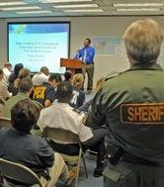
External Communication: Responders
Develop procedures with responders for:
Transferring command.
Ensuring interoperable communications.
Coordinating public information and outreach efforts.
Notes:
Routine and frequent communication with external response agencies is essential throughout the planning process. This section of the school EOP should include procedures that have been developed in advance with first responders for:
Transferring command. Procedures should be established to facilitate the transfer of command between the school and first responders. For example, in the case of an intruder or hostage situation, the initial Incident Commander may transfer command upon the arrival of an Incident Commander from the authorized law enforcement agency. When the situation is resolved, the law enforcement Incident Commander may transfer command to a school Incident Commander to oversee the reunification process and provision of crisis counseling.
Ensuring interoperable communications. It is critical to ensure that schools and emergency management/response personnel are able to communicate within and across agencies via voice, data, or other systems when needed, and when authorized.
Discussion Question: What systems will your school use to communicate with first responders during an incident?
Coordinating public information and outreach efforts. In a complex incident, the school Public Information Officer may become part of the Joint Information System. The mission of the Joint Information System is to provide a structure and system for developing and delivering coordinated interagency messages and developing, recommending, and executing public information plans and strategies.
The Joint Information System may be implemented at a Joint Information Center. It is the central point of contact for all news media.

Slide 87
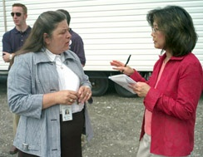
External Communication: Media
Designate a Public Information Officer.
Establish a Joint Information Center for complex incidents.
Develop templates for statements to the media, including:
Standard procedures and protocols.
Contact information/hotline for more information.
Notes:
Schools should plan ahead when developing a communications strategy intended for the media and general public. Planning includes:
Designating and training a Public Information Officer who will speak for the school.
Establishing a Joint Information Center for complex incidents.
Developing templates for statements to the media, including:
Standard procedures and protocols.
Contact information/hotline for more information.
How schools communicate with the media can greatly contribute to their ability to respond to and recover from an incident.
Rumors will circulate, especially with the use of cell phones and text messaging; however, schools can get out in front of the problem by articulating the measures being taken to address safety and health concerns. These measures and procedures come from a solid school EOP that is exercised and maintained.
In addition to the method of communication, the school EOP may include guidelines on the type of content and the tone of the message to be released.
Example: In March 2009, a student drowned during a school-sponsored event. The principal of the school responded to media queries by stating, “Look at the amount of times we’ve had something tragic occur and compare it to the number of times when nothing has happened.” Language like this deflects responsibility and can severely affect a school’s credibility in the future.

Slide 88
Continuity of Operations (COOP)
The COOP annex:
Outlines actions for continuation of essential functions immediately after an incident, until resumption of normal operations.
Enables a rapid response to any emergency situation.
Notes:
The continuity of operations (COOP) functional annex describes how a school and district will help ensure essential functions continue in an emergency and its immediate aftermath. Essential functions include business services (payroll and purchasing), communication (internal and external), computer and systems support, facilities maintenance, safety and security, and continuity of teaching and learning.
The planning team should consider the following when developing this annex:
Designing the COOP so that it can be activated at any time and sustained for up to 30 days.
Setting priorities for reestablishing essential functions, such as restoration of school operations, maintaining the safety and well-being of students, and re-creating the learning environment.
Ensuring that students receive appropriate related services in the event of a prolonged closure.
Note: The COOP plan may be a separate plan from the EOP. If a separate COOP plan is used, it should be identified in the EOP.
The COOP procedures may be defined at the district level for the school to follow. The COOP annex should be designed to operate in conjunction with the local community EOP, if defined at the district level, or designed to operate with the district COOP plan, if defined at the school level.
State law may dictate some provisions that must be addressed in a school COOP annex.

Slide 89
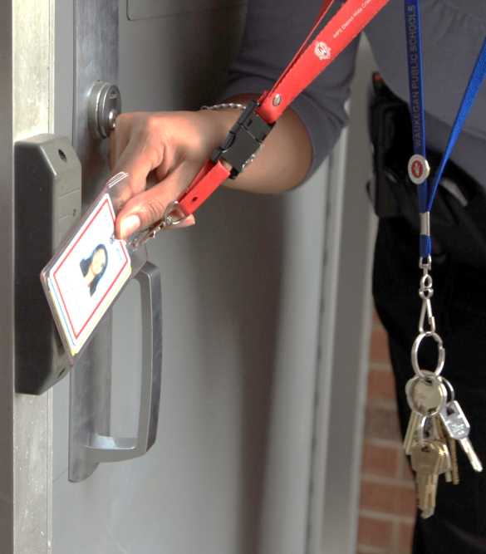
Security Annex
Potential topics:
Agreements with law enforcement
Physical security of the facility
Traffic control and pedestrian safety
Keeping prohibited items out of the school
Access control & visitor management
School threat assessment team policies
Cyber security procedures
Notes:
The security functional annex focuses on the courses of action the school will implement on a routine, ongoing basis to secure the school from criminal threats originating from both inside and outside the school.
The contents of this annex are derived from the safety and security assessments discussed in Unit 3. Potential topics include:
Agreements with law enforcement and how they address the daily role of law enforcement in and around school.
Measures to make the building physically secure (including implementation of Crime Prevention Through Environmental Design (CPTED), presented in Unit 3).
How to get students to and from school safely (including traffic control and pedestrian safety).
Measures to keep prohibited items out of school.
Policies and procedures for access controls and visitor management.
Policies and procedures for the school threat assessment team and how identified threats are to be handled, including how information will be shared with law enforcement or other responders, keeping in mind any requirements or limitations of applicable privacy laws, including the Family Educational Rights and Privacy Act of 1974 (FERPA), the Health Insurance Portability and Accountability Act of 1996 (HIPAA), and other civil rights laws.
Policies and procedures to maintain data security.

Slide 90
Functional Annexes Worksheets

Slide 91
School Plan Components
Notes:
Unit 3 presented the importance of conducting assessments to identify threats and hazards in order to develop a comprehensive school EOP. The process of developing threat/hazard-specific annexes builds on the information from the different school assessments.
In order to properly develop threat/hazard-specific annexes, the planning team:
Reviews the information gathered from the school’s threat and hazard assessments.
Considers what information is already included in any functional annexes that have been developed.
Identifies any gaps in the information provided.
Develops necessary threat/hazard-specific annexes.
Have participants use the Action Item Worksheet to help track and organize notes on threat/hazard-specific annexes presented in this unit.

Slide 92
Identifying Annexes
Threat/hazard-specific annexes:
Are only needed when a specific threat, hazard, or type of incident:
Presents unique challenges, or
Requires unique procedures, roles, and responsibilities.
Do not repeat information presented elsewhere in the plan.
Notes:
The number and types of threat- and hazard-specific annexes included in the school EOP should be based on the results of your security assessments and the identification of threats and hazards of greatest concern.
Not every threat or hazard requires an annex!
Select those that present unique challenges or unique procedures, roles, or responsibilities. Create a threat- or hazard-specific annex only if the given challenges are not sufficiently addressed in the basic plan or functional annexes. Therefore, the school EOP may not include a great number of threat or hazard annexes.
If there is a functional annex that applies to one of the threat or hazard annexes, the threat or hazard annex should include it by reference. For example, if a course of action for a fire hazard involves evacuation and there is an evacuation functional annex, the Fire Threat Annex would indicate “see Evacuation Annex” in the Fire Annex course of action section, rather than repeat the evacuation courses of action in the Fire Annex.
Don’t repeat information presented in the basic plan or functional annexes. Repeating information is not advisable for the following reasons:
School staff and students should learn and exercise simple procedures that apply to all threats and hazards. The threat and hazard annexes should present only unique information.
Repeating procedures increases the possibility that there will be inconsistencies in procedures that could lead to confusion during an incident.
The school EOP becomes larger and more difficult for users to comprehend.
Examples of threat/hazard-specific annexes in a school EOP include:
Hurricane/Severe Storm
Earthquake
Tornado
Hazardous Materials Incident
Mass Casualty
Active Shooter
Pandemic/Disease Outbreak
(Note: This is not a complete list. Planning teams must define annexes on the basis of their hazard/threat and security assessment.)

Slide 93
Developing Annexes
The threat/hazard-specific annex should:
Summarize where and how the given threat or hazard is likely to affect the school.
Focus on the needs for the given threat or hazard.
Include:
Any local, State, tribal, and Federal legal requirements.
Supporting documents.
Notes:
When developing your threat/hazard-specific annexes:
Summarize where and how hazards are likely to impact the school. The hazards may be:
Natural (e.g., earthquake, flood, hazardous weather, public health emergency).
Technological (e.g., infrastructure/utility disruption, radiological, or hazardous material release).
Human-caused (e.g., criminal or violent behavior, intruder, demonstration, active shooter, terrorism).
Focus on the planning, mitigation, and response needs for a given hazard. This includes any provisions and protocols for warning the public and disseminating emergency public information.
Include:
Information on legal requirements as directed by specific local, State, and Federal laws.
Supporting documents as needed to clarify contents of the basic plan.
For example, in the case of a terrorist incident the lead agency nationwide is the Federal Bureau of Investigation. There may be State laws governing response authorities for certain types of incidents. It is important to consult legal counsel or research State laws when developing threat/hazard-specific annexes.

Slide 94
Annex Example: Pandemic Flu
People may have little or no immunity to a flu virus.
Pandemic influenza:
Causes serious illness.
Spreads easily person to person.
Can sweep around the world in a short time.
Notes:
Now that you know what should be included in a threat/hazard-specific annex, let’s look at some examples of hazards that you may want to include.
While people may think of tornadoes or wildfires as natural hazards, pandemic disease such as influenza is also a natural hazard and you may want to include procedures in your school EOP to address the pandemic flu.
Depending on the viral strain, the population may have little to no immunity to a flu virus. In these cases, influenza may:
Cause serious illness.
Spread easily from person to person.
Sweep across the country and around the world in a very short time.
Discussion Questions:
Does your school plan address pandemic flu?
What about your district and community plans?
What procedures would your school follow in the event of a pandemic flu outbreak?
Facilitate the discussion: Acknowledge the responses. If not mentioned by the participants, note that procedures specific to the flu may include reporting the numbers of students and/or staff and faculty with flu-like symptoms to local health officials and promoting prevention through hand washing and social distancing.
The CDC advocates simple actions that everyone can do to stay healthy, including:
Covering your nose and mouth with a tissue when you cough or sneeze.
Washing your hands often with soap and water, especially after you cough or sneeze.
Avoiding touching your eyes, nose, or mouth.
Staying home if you get sick.
The CDC also recommends that people with the flu should stay at home until 24 hours after the fever is gone. Other people in their household should also, to the degree possible, minimize outside contact during this time. State and local health agencies may have different recommendations, depending on the risk to local communities.
A school should take these recommendations into account when developing the response procedures for a flu outbreak.
The Centers for Disease Control and Prevention (CDC) has developed recommended actions to take for each school year. Check the CDC Web site (http://www.cdc.gov), search topic: school health.

Slide 95
Annex Example: School Violence
School violence:
Can be directed at students or faculty/staff.
Includes bullying, cyberbullying, slapping, punching, weapon use, and sexual assault.
Notes:
Schools may also want to include a threat/hazard-specific annex on school violence. School violence:
Can be directed at students or faculty/staff.
Includes bullying, cyberbullying, slapping, punching, weapon use, and sexual assault.
May involve one or more schools, as in gang violence and inter-school rivalries.
Information on school violence can be obtained from at the CDC Web site (http://www.cdc.gov), search topic: school violence.
Discussion Questions:
Does your school plan address school violence?
What procedures does your school follow?
Facilitate the discussion: Acknowledge the responses. If not mentioned by the participants, note that a school plan can address both procedures to follow after an incident of school violence as well as actions to take to prevent violent acts from occurring. The school EOP may include some of the following procedures addressing school violence:
Implementing anti-bullying, anger management, and other programs.
Encouraging students, faculty, and staff to report instances of violence or suspicious behavior to an anonymous law enforcement tip line.

Slide 96
Threat and Hazard Specific Annexes

Slide 97
Plan Review, Approval, and Dissemination
Notes:
Once the entire plan (including basic plan and annexes) is written, the next step in the planning process is the review, approval, and dissemination of the school EOP.

Slide 98
Reviewing the School EOP
When reviewing the school EOP, make sure it is:
Adequate.
Feasible.
Acceptable.
Complete.
Compliant.
Notes:
Your plan should be reviewed to ensure compliance with the legally mandated planning requirements in your State and for its usefulness in practice. Plan review allows stakeholders with emergency responsibilities to suggest improvements.
Review the plan to check for:
Adequacy.
Does it identify critical courses of action?
Can it accomplish the assigned function?
Are all assumptions valid and reasonable?
Feasibility.
Does your school have the resources to fulfill the functions and critical tasks?
Does it identify where the school will obtain resources outside of the school’s capabilities?
Acceptability.
Does it thoroughly address the identified threats, hazards, and vulnerabilities?
Is it consistent with legal requirements?
Does it meet time and cost limitations?
Completeness.
Does it include all the courses of action to be accomplished?
Does it integrate the needs of the whole school population?
Does it provide a complete picture of what should happen, when, and at whose direction?
Does it make time estimates for achieving objectives, with safety remaining the utmost priority?
Does it identify success criteria and a desired end state?
Is it developed consistently with the planning principles in CPG 101 and Guide for Developing High-Quality School Emergency Operations Plans?
Compliance.
Does it comply with State and local requirements to the maximum extent possible?
Note: Specific laws and mandates differ from State to State. School EOPs should be reviewed to ensure compliance with the legally mandated planning requirements in their State before presenting the school EOP to stakeholders for approval.
Allowing other agencies with emergency or homeland security responsibilities to review your plan will enable them to suggest improvements based on their accumulated experience. FEMA regional offices or State emergency management offices may assist schools in the review process upon request.

Slide 99
School Emergency Management Workshop 3
Brad Stiles, MA, Emergency Response Outreach Consultant
Colorado School Safety Resource Center
Colorado Department of Public Safety

Slide 100
Step 6: Plan Implementation and Maintenance
Train stakeholders on the school EOP and their role.
Exercise the plan.
Review, revise, and maintain the school EOP.
Notes:
The next step in the CPG planning process is implementing and maintaining the plan, which includes training, exercising, and updating the plan.
Training: Staff and students need to have the knowledge, skills, and abilities to perform the tasks and school-specific procedures identified in the school EOP.
Exercising: Evaluating the effectiveness of the school EOP involves a combination of training events, exercises, and real-world incidents to determine whether the goals, objectives, and actions outlined in the plan will support a successful response. Exercise programs are an integral part of the planning process.
Reviewing, revising, and maintaining the plan: This step closes the loop in the planning process. It focuses on using the information gained from activating or exercising the plan to revise the plan.

Slide 101
Training and Exercises
Training and exercises should:
Address different audiences.
Be age-appropriate.
Vary.
Recur.
Notes:
In order for the school EOP to serve its intended purpose, it needs to become part of the culture, not just a document on the shelf. Conducting training and exercises helps to incorporate the school EOP into your school culture. The more your school EOP is practiced and stakeholders are trained on its contents, the more effectively they will be able to act before, during, and after an emergency to lessen the impact on life and property.
Training and exercises provide opportunities to work with community partners, and exercises help to identify gaps and weaknesses in your school EOP.
When planning training and exercises, ensure they:
Address different audiences: Training and exercises should be provided for all target audiences. Examples of different school audiences include:
Staff, such as administrators, teachers, substitute teachers, support staff (e.g., cafeteria workers, maintenance staff, custodians, bus drivers, and crossing guards), and volunteers.
Students, including those with disabilities, limited English proficiency, or other access and functional needs.
Parents, guardians, and caregivers, including traditional and nontraditional family units (e.g., divorced/multiple households) and those with limited English proficiency.
Are age-appropriate: Concepts should be presented in a manner that can be easily understood and that ensures the target audience is prepared, not frightened.
Vary: Variation helps create “new” interest in an “old” topic. Add variety by using:
A formal preparedness curriculum, with prepared courses for all grade levels.
Reminder-level training, such as posters, signs, or a “tip of the day.”
Activities that are linked to Standards of Learning (SOLs), such as hazard hunts for school and home, storybooks, checklists, experiments, writing and drawing activities, or a themed science fair.
Guest speakers and classroom visitors, such as:
Emergency management personnel.
Search and rescue teams.
Specialized skills training, such as Community Emergency Response Team (CERT or Teen CERT) training.
Both small-scale and large-scale training exercises. Exercises may be conducted under varying conditions to test capabilities.
Both discussion-based and hands-on training.
Recur: The school EOP shouldn’t “gather dust” on the shelf. Periodic training and exercises provide reminders and refresh learning.
Key point: It is important to conduct refresher training to reinforce and remind staff, students, and parents/guardians of previously acquired knowledge and skills.

Slide 102
Benefits of Exercising a School EOP
Raise awareness of potential crisis situations.
Assess and validate policies, plans, procedures, training, equipment, assumptions, and partnerships.
Clarify roles and responsibilities.
Improve partnership, coordination, and communication.
Identify gaps in resources.
Measure performance.
Identify opportunities for improvement.
Notes:
Exercises will help you to evaluate your school EOP, procedures, equipment, facilities, and training. Through exercises, school(s) can:
Raise awareness of potential crisis situations.
Assess and validate policies, plans, procedures, training, equipment, assumptions, and partnerships in a safe and controlled environment.
Clarify roles and responsibilities.
Improve partnerships, coordination, and communication.
Identify gaps in resources.
Measure performance.
Identify opportunities for improvement.
The purpose of exercising the school EOP is to see how well the procedures and systems outlined in the plan worked.
Emphasize that exercises test the plan, not the personnel participating in the exercises.
By conducting exercises, your school can gain public recognition that you are concerned about—and actively involved with—the safety of your children and the protection of school property.

Slide 103
Types of Exercises
Notes:
There are two main categories of exercises: discussion-based and operations-based.
Discussion-based exercises:
Include seminars, workshops, tabletop exercises, and games.
Can be used to familiarize players with or develop new school EOP, policies, agreements, and procedures.
Focus on strategic, policy-oriented issues.
Are usually led by facilitators and/or presenters, keeping participants on track toward meeting exercise objectives.
Operations-based exercises:
Include drills, functional exercises, and full-scale exercises.
Can be used to validate school plans, policies, agreements, and procedures; clarify roles and responsibilities; and identify resource gaps.
Are characterized by actual response to an exercise scenario, such as initiating communications or mobilizing personnel and resources.
Regardless of the type of exercise selected, schools should:
Initially practice a small part of the school EOP or one specific procedure. Later exercises can then address the coordination of several functions simultaneously.
Conduct exercises whenever new equipment is purchased or installed, or when new policies or procedures are developed.
Key point: Emphasize the importance of beginning with simple or narrowly focused exercises and gradually building in complexity.
Transition: Tell participants the following visuals present detail on types of discussion-based and operations-based exercises. The presentation will begin with discussion-based exercises.

Slide 104
Discussion-Based: Seminars
Provide an overview of plans, policies, or procedures.
Are valuable when making changes to plans or procedures.
Notes:
Seminars:
Generally orient participants to or provide an overview of authorities, strategies, plans, policies, procedures, protocols, resources, concepts, and ideas.
Can be valuable for when schools are developing or making major changes to the existing school EOP or procedures.
Can be similarly helpful when attempting to assess or gain awareness of the capabilities of interagency or inter-jurisdictional operations.

Slide 105
Discussion-Based: Workshops
Produce or build a product.
Should involve the broadest attendance by relevant stakeholders.
Must have clearly defined objectives or goals.
Notes:
Although similar to seminars, workshops differ in two important aspects:
Participant interaction is increased.
The focus is placed on achieving or building a product.
Effective workshops entail the broadest attendance by relevant stakeholders. Products produced from a workshop can include new standard operating procedures, school EOPs, continuity of operations plans, or mutual aid agreements.
To be effective, workshops should focus on a specific issue and should have clearly defined:
Objectives,
Products, or
Goals.

Slide 106
Discussion-Based: Tabletops
Enhance general awareness.
Validate the school EOP.
Assess systems needs.
Introduce community partners to new plans and procedures.
Identify potential challenges and identify solutions.
Range from simple to complex.
Notes:
Purpose of tabletops. A tabletop exercise is intended to generate discussion of various issues regarding a hypothetical, simulated emergency. Tabletop exercises can be used to:
Enhance general awareness.
Validate the school EOP and procedures.
Rehearse concepts and/or assess the types of systems needed to guide a defined incident.
Facilitate conceptual understanding, identify strengths and areas for improvement, and/or achieve changes in perceptions.
During a tabletop, players are encouraged to discuss issues in depth, collaboratively examining areas of concern and solving problems. The effectiveness of a tabletop exercise is derived from the energetic involvement of participants and their assessment of recommended revisions to current policies, procedures, and the school EOP.
Level of complexity. Tabletops can range from basic to complex.
Basic. In a basic tabletop (such as a facilitated discussion), the scenario is presented and remains constant—it describes an emergency and brings participants’ discussion up to the simulated present time. Players apply their knowledge and skills to a list of problems presented by the facilitator; problems are discussed as a group; and resolution is reached and documented for later analysis.

Slide 107
Operations-Based: Drills
Validate a specific function or capability.
Practice or maintain current skills.
Must be based on clearly defined plans and procedures.
Notes:
One type of operations-based exercise is the drill. A drill is a coordinated, supervised activity that:
Is usually employed to validate a specific function or capability in a single organization, such as a school.
Is commonly used to provide training on new equipment, validate procedures, or practice and maintain current skills. For example, drills may be appropriate for practicing evacuation procedures.
Must be based on clearly defined plans and procedures,
Drills can also be used to determine if procedures can be executed as designed, to assess whether more training is required, or to reinforce best practices. A drill is useful as a stand-alone tool, but a series of drills can be used to prepare several organizations to collaborate in a full-scale exercise.
Emphasize the following points because they relate directly to the final activity in this unit.
To successfully conduct a drill:
The school EOP, policies, and procedures must be clearly defined and personnel must be familiar with them.
Personnel must be trained on the processes and procedures to be drilled.
It must be clear that a drill is being conducted, and that the situation is not an actual emergency.
There must be a process to evaluate the drill and provide feedback.
Discussion Question: What drills will you use to exercise your plan?
Facilitate the discussion: Acknowledge the responses and tell participants two common types of drills are those that test communications and those that test response procedures.
Transition to the next visual by telling participants you will first discuss communications drills.

Slide 108
Communications Drills
Used to review and test communications protocols:
External communications
Internal communications
Vertical communications
Notes:
Communications drills are used to review and test communications protocols, including:
External communications: Between different groups (e.g., your staff and various response agencies or community groups).
Internal communications: Among personnel within your building, such as between main office and individual rooms or groups that are outside the building.
Vertical communications: Between your school and your school district.
These types of drills can verify communications before conducting response drills.

Slide 109
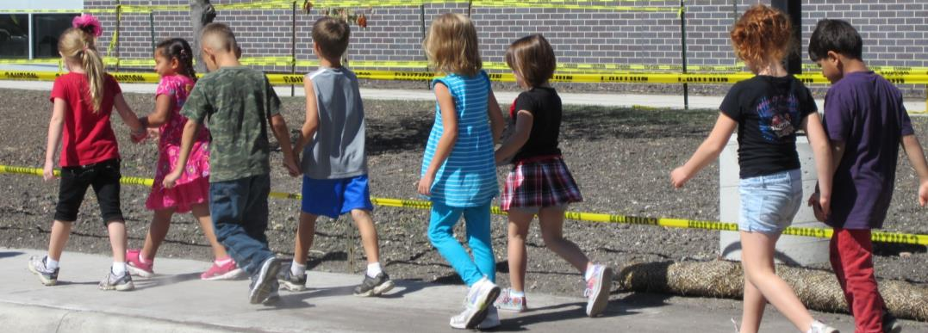
Response Drills
Provide practice in specific emergency action.
Can be:
Facility-wide.
Initiated by staff with a subset of the population.
A combination of drills.
Notes:
Response drills:
Provide practice in specific emergency actions that may be required during an incident.
Can be facility-wide operations.
Can be initiated by staff with a subset of the population.
Can be combination drills that are created by combining response actions in a single drill.
Examples of response drills include:
Evacuation drills.
Lockdown drills.
Reverse evacuation drills.
Room clear drills.
Review the example on the following page with participants, emphasizing that a drill can be simple or more complex.
Response Drill: Example
A private school in Michigan conducted a response drill to test their family reunification procedures. The 3-hour drill started with a fake bomb threat. Once the explosives had been “located,” students were evacuated to the secured front of the school and counted.
Once accounted for, students were led to a designated safe location at the church across the street (the street was closed for the sake of the exercise).
Next, parents were notified that their children could be picked up by the individual(s) designated in the school records. When parents began arriving at the safe site, students were brought from the basement of the building, linked with their photo-identified parents or designee, and allowed to exit through a tunnel. Following the event, a debriefing occurred among staff and emergency management.
Discussion Question: What type of complex drills has your school or district conducted? How were they developed and designed?
Acknowledge the responses.

Slide 110
Tips for Conducting Drills
Keep drills realistic and unpredictable.
Conduct drills during:
Class change.
Recess and lunch times.
Arrival and dismissal.
Field trips.
Notes:
Emergency situations may occur at any time during the day or year. It is beneficial to conduct drills in ways that reflect this variability. Make the drills realistic, but do so safely. For example, vary the times and conditions for drills, to include:
Class change.
Recess, gym classes, social hours, events, and meetings.
Arrival and dismissal times.
Times when food service areas are occupied.
After hours (e.g., dances, theater, athletic events, or community functions).
Discussion Question: What are some ways you would add realism to your school drills? If not mentioned, suggest:
During an evacuation drill, block normal routes or use human “blockers.”
Remove individuals during a drill to see how long it takes to notice and act.
Remove a staff member (unannounced) from his/her group to see if individuals in the group can follow procedures on their own.
Conduct drills as people arrive in the morning or around dismissal time. Identify unique issues that arise during these times.
Conduct spontaneous drills with specific groups—for instance, to see how quickly a room can go into lockdown mode.

Slide 111
Operations-Based: Functional Exercises
Evaluate and validate capabilities or multiple functions.
Focus on exercising the school EOP, policies, and procedures.
Involve a scenario with event updates.
Are realistic, real-time.
Simulate use of personnel and equipment.
Notes:
Functional exercises:
Are designed to validate and evaluate capabilities, multiple functions and/or sub-functions, or interdependent groups of functions.
Are typically focused on exercising the school EOP, policies, procedures, and staff members involved in management, direction, command, and control functions.
Have events that are projected through an exercise scenario with event updates that drive activity, typically at the management level.
Are conducted in a realistic, real-time environment; however, movement of personnel and equipment is usually simulated.
Functional exercise controllers typically use a Master Scenario Events List to ensure participant activity remains within predefined boundaries and to ensure exercise objectives are accomplished.
A functional exercise may:
Involve various levels of school, school district, and emergency management personnel.
Involve the simulation of an emergency event that requires rapid responses by trained personnel “acting out” their actual roles.
Evaluate both the internal capabilities and responses of the school, school district, and emergency management officials.
Evaluate the coordination activities between the school, school district, and emergency management personnel.
To successfully conduct a functional exercise:
Provide participants a thorough briefing that includes exercise objectives, exercise background, ground rules, and procedures.
Keep the exercise as real as possible.
Allow players to use the same resources that would be available to them during an actual emergency.

Slide 112
Operations-Based: Full-Scale
Are the most complex and resource-intensive exercise type.
Involve multiple agencies and organizations.
Involve an exercise scenario conducted in real time.
May mobilize personnel and resources.
Notes:
Full-scale exercises simulate reality by presenting complex and realistic problems that require critical thinking, rapid problem solving, and effective responses by trained personnel. Full-scale exercises:
Are typically the most complex and resource-intensive type of exercise.
Involve multiple agencies, organizations, and jurisdictions and validate many facets of preparedness and often include many players operating under cooperative systems such as the Incident Command System (ICS).
Have events that are projected through an exercise scenario, with event updates that drive activity at the operational level and are usually conducted in a real-time, stressful environment that is intended to mirror a real incident.
Often involve personnel and resources being mobilized and deployed to the scene, where actions are performed as if a real incident had occurred.
The level of support needed to conduct a full-scale exercise is greater than that needed for other types of exercises. The exercise site is usually large, and site logistics require close monitoring. Safety issues, particularly regarding the use of props and special effects, must be monitored. Throughout the duration of the exercise, many activities occur simultaneously.

Slide 113
Activity: Training Ideas
Instructions:
Identify one incident that you would like to train with:
Parents/guardians
Substitutes
Volunteers
After-school groups
Create a training plan for the school year, identifying which response function(s) and what type(s) of training or exercises you will use.
Notes:
Preparation: Assign each table group an audience (students, staff, or parents/guardians) to train on procedures from the EOP.
Purpose: This activity will enable the participants to identify procedures in the EOP that should be trained with students, staff, and parents/guardians.
Estimated Completion Time: 15 minutes (10 minutes activity + 5 minutes debrief)
Instructions: Working with your group . . .
Identify three procedures from the EOP that you should train and exercise with the audience assigned by the instructor: students, staff, or parents/guardians.
Identify how you will deliver each training (e.g., in-service days, brown bags, parent teacher conferences, etc.).
Be prepared to report your results in 10 minutes.
Debrief: After 10 minutes, facilitate a discussion as described below.
Debrief: Ask each team to present their suggested training and how the training will be delivered for the assigned target audience.
Facilitate the discussion: Acknowledge the responses. If one of the audiences was not assigned (students, staff, or parents/guardians), have a class discussion on training for that group.
If not mentioned, provide the following examples:
Students: Presenting lockdown procedures, evacuating the building, and reassembling the class at an outdoor location.
Staff: Identifying and mitigating hazards in the classroom, evacuating the building, performing first aid, and checking and shutting off utilities.
Parents/guardians: Identifying and mitigating hazards in the home, staying informed after an incident (e.g., locating information via the school Web site or email notifications), and following post-incident reunification procedures.
Transition to the next section by telling participants that they need to train before they can effectively conduct exercises.

Slide 114
Exercise Design and Development
Notes:
As discussed at the beginning of this unit, HSEEP provides a methodology for planning and conducting individual exercises. The first four steps comprise exercise design and development, including:
Setting the exercise foundation by determining exercise priorities based on your school and district priorities and your school’s assessments.
Identifying an exercise planning team to plan, design, and develop the exercise.
Designing the exercise:
Determine the type of exercise to conduct.
Identify exercise duration.
Identify exercise parameters (i.e., what should be included in the exercise and what should not).
Set exercise objectives.
Identify evaluation requirements that clearly articulate what will be evaluated during the exercise and how exercise play will be assessed.
Develop the scenario that is the sequence of events for the exercise. This can be a written narrative or an event timeline.
Determine the threat or hazard on which the exercise will focus.
Develop exercise documentation to ensure an accurate account of the exercise and to provide information on the exercise. This documentation may include a facilitator guide, a presentation for participants, an exercise plan, a synopsis of the exercise, player handouts, controller and evaluator packets, an events list, evaluation guides, participant feedback forms, and media release forms.
Determine media and public relations guidance.
Developing the exercise:
Plan the logistics including the room, food, supplies, and audio/visual needs.
Determine the badging and identification requirements.
Identify if actors will be needed to add realism.
Plan for exercise control including the number of controllers needed, how control will be communicated, how controllers will be trained, and what the controllers’ role is for safety and security.
Develop a comprehensive plan to address how the exercise will be evaluated.

Slide 115
Exercise Conduct and Evaluation
Notes:
After design and development, the exercise is conducted and evaluated.
Exercise Conduct:
Prepare for the exercise:
Conduct a stakeholder meeting to confirm responsibilities of all entities.
Brief all participants in roles and responsibilities. Do this in advance to avoid any confusion or concern.
Coordinate with security personnel and law enforcement—invite them to participate or observe.
Check all communication systems relating to emergency notification and ensure consistent emergency management terminology will be used.
Set up the exercise site.
Conduct the exercise:
Conduct the exercise first with staff.
Then conduct the drill with staff, students, parents/guardians, and community partners and under different circumstances and non-ideal situations.
Wrap up the exercise:
Immediately following the exercise, conduct a debriefing with the planning team to ascertain their level of satisfaction and any concerns or issues.
Immediately following the exercise, conduct a hot wash with exercise participants to discuss exercise strengths and areas for improvement.
Conduct a controller/evaluator debriefing to provide the controllers and evaluators the opportunity to discuss observations, strengths, and areas for improvement.
Exercise Evaluation:
Plan for the exercise evaluation:
Develop an exercise evaluation guide.
Identify and train evaluators.
Brief evaluators.
Observe the exercise:
Evaluators observe many topics including plans, policies, roles, responsibilities, decisions made, and requests for resources.
Evaluators take notes.
Document the exercise results. Analyze the exercise observations and develop an after-action report draft that summarizes key information related to the evaluation. Questions to consider for the after-action report include:
What worked well?
Were objectives met?
Were critical tasks executed satisfactorily?
Do current plans, policies, and procedures support critical tasks and objectives?
What needs to be improved?
What should be our next steps?
How will we track completion of the improvement steps?

Slide 116
Topic Overview

Slide 117
Tabletop Exercise Participants
Notes:
For a tabletop exercise to succeed, it needs to be managed and evaluated properly. It is important to identify and prepare the participants because they are key to the exercise’s success.
Exercise facilitators supervise the overall conduct of the exercise, making certain that the tabletop exercise proceeds as planned and that objectives are reached. The main duties of the exercise facilitator are to:
Set up the exercise by introducing the narrative.
Facilitate problem solving among the players including controlling the pace and distributing messages.
Assist with discussion, ensuring all issues and objectives are explored as thoroughly as possible within time constraints.
Exercise players review the roles to be played and determine who will perform the roles. Players perform the role as they would in the actual emergency by following the procedures in their emergency plan.
Key point: In determining the players to be included in a tabletop exercise, schools should consider the type of scenario and the overall objectives of the exercise. For example, some schools have conducted exercises focused on post-incident recovery in which all of the players were either school nurses, counselors, psychologists, or social workers.
Evaluators observe the actions and decisions of the players in order to later report what went well and what needs improvement. To do this, evaluators need to be familiar with the objectives, exercise scenario, and organization(s) participating in the exercise. The main duties of the evaluators are to:
Review the exercise objectives and observe the actions and decisions of the players as they relate to the objectives.
Review the evaluation criteria and refine the evaluation checklists to document the observations during the exercise.
Document observations, capture unresolved issues, and analyze exercise results.
Key point: In selecting people to serve as evaluators for a tabletop exercise, schools should consider including local collaborative partners (e.g., first responders, health department, various subject matter experts). These partners can contribute an important perspective to the process. They can also employ the hot wash as a “teachable moment” to train the participants on best practices.
Exercises provide an excellent opportunity to engage in collaborative planning, training, and drilling in one setting.
Observers do not directly participate in the exercise; rather, they observe selected segments of the exercise as it unfolds, while remaining separated from player activities. In a tabletop exercise, observers may support the development of player responses to the situation by asking relevant questions, delivering messages, or citing references; however, they generally do not participate in moderated discussion. In this activity, the same individuals will serve as both observers and evaluators.
Key point: When schools conduct exercises, it is beneficial to include observers from other campuses or districts. This is a good way to deliver economy-of-scale across a jurisdiction.

Slide 118
Conducting the Tabletop
Welcome players & introduce facilitator/evaluators.
Present exercise purpose.
Explain exercise conduct.
Introduce narrative and significant events.
Ensure all players are involved.
Encourage and facilitate problem solving.
Control pace and flow of exercise.
Evaluate exercise progress.
Notes:
Tabletop exercises are managed by an exercise facilitator who has several key responsibilities to ensure that the exercise proceeds as planned, which include:
Welcoming the participants and putting them at ease.
Introducing himself or herself and the evaluators and observers.
Presenting the purpose of the exercise.
Explaining to the players how the exercise will be conducted, including the roles of the exercise facilitator and evaluators.
Introducing the narrative and the significant events.
Ensuring all players are involved.
Encouraging and facilitating problem solving.
Controlling the pace and flow of the exercise.
Evaluating exercise progress.

Slide 119
Activity: Conduct the Tabletop
Instructions:
Read the scenario assigned by the instructor.
Working in your school team, use the school EOP to guide your answers.
Respond to updates and new questions using the EOP.
Notes:
Purpose: This activity will provide an opportunity to exercise the school EOP by participating in a tabletop exercise. The school will need to use its EOP to make decisions about how to respond to each of the events.
Explain how the tabletop exercise will work, using the information below.
Objectives of the tabletop are to:
Demonstrate the ability to use the Incident Command System principles.
Determine the effectiveness of the operational organization that manages the incident.
Assess the ability to establish and maintain communications during an incident.
Determine the adequacy of equipment, supplies, and facilities during an incident.
Scenario and updates. An initial scenario will be presented and then new information about the scenario will be added at intervals throughout the exercise. This information will require a reevaluation of the situation and decision-making based on the new data in much the same way as during an actual event.
Messages. Questions (messages) will be posed after the initial scenario and each scenario update. Throughout the exercise, the instructor will monitor the exercise to encourage problem solving, ensure everyone participates, control the pace, and evaluate the exercise.
Explain that you will facilitate the tabletop, and that your role is to introduce the scenario and the messages/updates, ensure everyone is involved, encourage problem solving, and control the exercise pace. Describe the role of any other instructor(s) as facilitator(s), observer(s), or evaluator(s).
Estimated Completion Time: 1 hour 30 minutes
Distribute the first part of the selected scenario to each participant. At the designated intervals, give each team member the scenario update. Remember to use the steps for effective facilitation of a tabletop:
Monitor the pace of the discussion, following the timing guidelines but adjusting based on how the participants are proceeding.
Encourage involvement to ensure everyone is contributing and participating.
Manage the time with a balance between allowing the players to spend enough time on each issue to produce thoughtful solutions and moving quickly enough to keep the discussions stimulating.
Instructions: Working as a school team . . .
Read the scenario.
Use your school EOP to respond to the scenario questions and updates.
Identify one person to document your responses.
Select one person to present the school’s responses to the scenario questions at the end of the activity.
Document your observations and take notes during the exercise in order to provide a thorough debrief.

Slide 120
Evaluation
At the end of the tabletop:
Assess how well the exercise objectives were achieved.
Identify opportunities for improvement for:
Improved response capabilities.
Revising plans, policies, and procedures.
Notes:
Exercise evaluation:
Assesses how well the exercise achieved the exercise objectives being tested.
Identifies where the plan was successful or not during the tabletop.
Identifies opportunities for improvement, including improved response capabilities and needed revisions of plans, policies, and procedures. The focus should not be on the performance of each individual player but rather on how well the policies, plans, and procedures worked.
Standard checklists to record observations during the tabletop are helpful to ensure data collected is uniform and consistent.

Slide 121
Activity: Debrief the Tabletop
Instructions:
Present your school’s responses to the scenario questions and identify:
Strengths
Areas of improvement
Discuss the following questions:
What worked well in this tabletop exercise?
What changes would you suggest?
Notes:
Purpose: This activity will enable participants to discuss the tabletop scenario, including what worked well for them and what changes they would suggest.
Estimated Completion Time: 1 hour (If there are multiple schools or teams, the time to complete the activity will increase.)
Instructions:
Present your responses to each of the questions in the tabletop.
Make notes on strengths and areas of improvement. You will need this information for the next activity.
Discuss:
What worked well in the tabletop exercise?
What changes in the tabletop would you suggest?
Have the table groups present the responses to each scenario question. Using the instructor guide, your experience, and your observation notes, provide feedback to the school on each scenario question.
There are few questions in the exercise that have a single correct answer. As you debrief the exercise, do not look for a “book” response. Rather, consider the rationale for the groups’ responses when providing your feedback.
Discussion Question: What worked well in the tabletop exercise? What changes would you suggest?
Facilitate a discussion of the effectiveness of the tabletop exercise.
If not mentioned, add your observations about what went well with the tabletop and what changes you would suggest.
Let the participants know that at the end of this unit they will design a tabletop to conduct at their school.

Slide 122
After-Action Report
The after-action report includes exercise findings from both player and evaluator feedback and includes:
Executive summary or introduction.
Why the exercise was conducted.
Exercise summary.
Strengths and areas for improvement.
Recommendations and corrective actions.
Notes:
After conducting an exercise, it is important to document the overall effectiveness to:
Plan future training and exercises.
Revise plans, policies, and procedures.
Take other corrective actions, such as purchase of equipment to support redundant communications methods.
As a team, develop the after-action report from exercise observations and notes, by:
Comparing all notes and observations from the exercise.
Resolving discrepancies in events or expected actions.
Agreeing on what worked and did not work during the exercise, including the degree to which the exercise objectives were achieved.
Deciding on the contents of the after-action report.
The complexity of the after-action report varies from a simple memorandum to a more formal report with:
An executive summary or introduction that describes the main purpose of the report, why it is being submitted, a preview of the main report topics, and the evaluation methodology used.
Why the exercise was conducted.
An exercise summary that includes information such as:
The exercise goals and objectives.
Activities that took place before the exercise to ensure that a location is identified, materials are copied, and all other exercise needs are met.
A list of the players and the agencies or organizations they represented.
A brief description of the exercise scenario.
Strengths and areas for improvement:
Evaluation group findings.
Summary of the after-action review.
Recommendations and corrective actions, including:
Training needs.
Changes required to plans, policies, and procedures.

Slide 123
Topic Overview
Notes:
The first part of the unit provided an opportunity to assess elements of your school EOP by participating in a tabletop exercise.
In the next part of the unit, you will learn about and apply the process for designing a simple tabletop: assemble a planning team, select an exercise, develop objectives, select exercise players, develop the exercise, conduct the exercise, and evaluate.

Slide 124
Designing Tabletop Materials
Describe context and direction.
Provide background information.
Establish a common frame of reference.
Present new information.
Prompt expected actions.
Provide information.
Complicate the exercise.
Initiate specific actions.
Notes:
Tabletop design and development follows the process presented in Unit 7 of the G364 course. Once an exercise planning team is assembled and has identified the goals and objectives for an exercise, the next step is to design the specifics of the exercise.
Emphasize that tabletop design and development takes time and planning.
Tabletop materials may include:
Narrative: A scenario, or brief description of the events that have occurred up to the minute the exercise begins. The exercise narrative provides:
Context and direction for the exercise by presenting a realistic scenario description. The exercise narrative:
Sets the mood for the exercise.
Captures the participants’ attention and motivates them to continue.
Enables them to examine policies, procedures, and the current status of their capabilities to manage emergency response.
Background information—conditions and technical details that the participants will need to consider during the exercise.
Common frame of reference for all exercise participants.
Key points:
Scenarios should be realistic, plausible, and challenging without being overwhelming.
When designing a narrative consider the:
Season.
Time of day.
Initiating incident.
Impact on immediate and extended areas.
How the incident unfolds.
Other factors that could impact response.
Significant events: Important events that affect the scenario and the decisions the players make as they respond to the scenario.
When designing the significant events, consider actions you want people to take to address the exercise objectives.
Messages: Notices that convey information about significant events to players. Messages, or injects, can be used to:
Provide information to players in the exercise.
Complicate the exercise in a way that might reasonably occur in a real incident.
Direct or redirect the play.
Initiate specific actions on the part of the players.
Distract the players in much the same way as they might be distracted during a real incident.
When designing messages, think about who could send a message and what that person could say to motivate the expected action to meet an exercise objective.

Slide 125
Adding perspective
Has the threat or hazard occurred in the past in your community? Has it ever occurred in a similar or nearby community? Can you add historical notes, pictures, press clippings or other information to your scenario?
By adding this perspective you can make a scenario come to life and add a real world feel to your exercise?

Slide 126
Adding perspective
Consider providing participants with real life pictures, maps, weather reports (from NOAA), in an effort to put the participants in the moment.

Slide 127
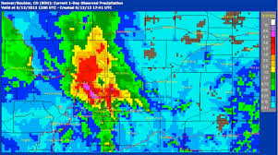
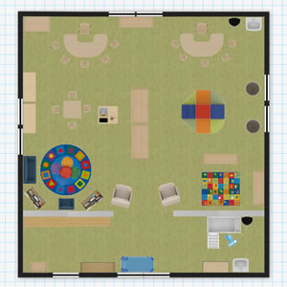
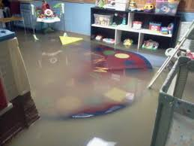

Slide 128
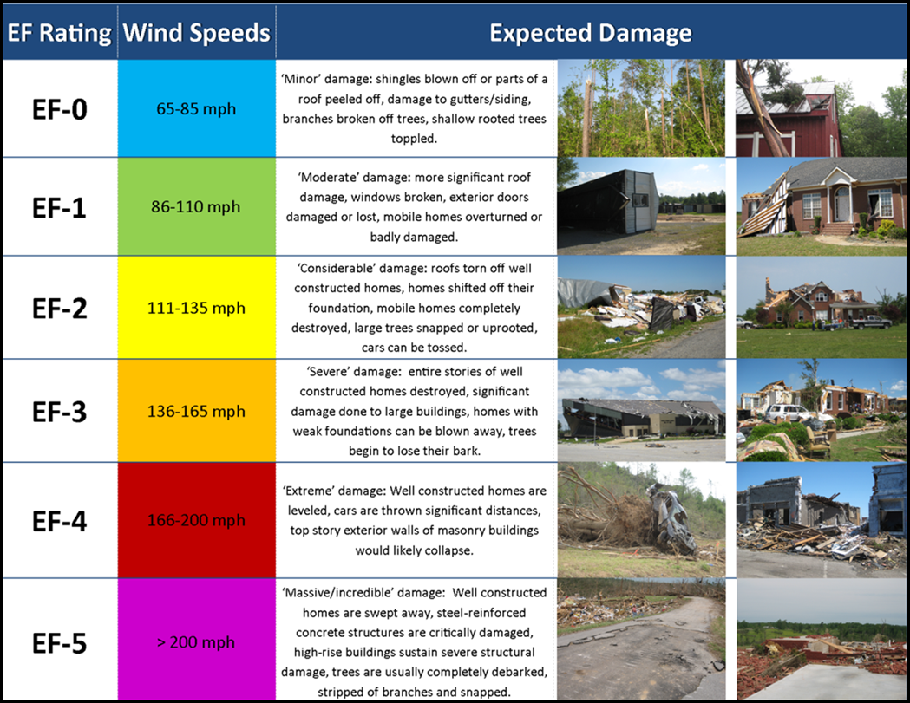
For instance…
MERICA
C.R. 45
C.R. 456
SHERTIN M.S.
US 129

Slide 129
Shertin Tornado
Example: On today’s date at 11:15 am, the Shertin Middle School Principal receives word from a concerned staff member that a funnel cloud was witnessed just ½ a mile north of the school. The principal turns on his weather radio and hears that several F2 tornados have recently touched down in Merica, a small town 3 miles to the north.

Slide 130
Significant activities
Used to guide the exercise
Consider if participants need to change focus or refocus, based on the desired outcome of the exercise
Prompt participants to use EOP or certain functions.
i.e. the tornado scenario just described does not cause participants to use shelter-in-place functions, the facilitator may need to ramp up the perceived danger

Slide 131
Shertin Tornado
Example: The school janitor rushes into the office and reports seeing a tornado on the ground, north of the gymnasium and that he saw a small shed on a neighboring property, “just blown away.”

Slide 132
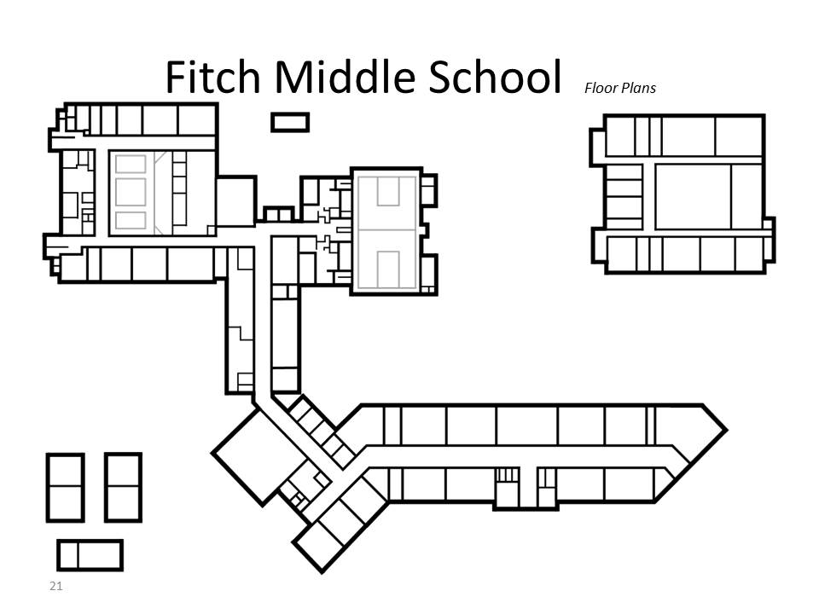
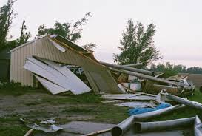
Capture the moment …

Slide 133
Messages or injects
Used to further guide the exercise and/or test other portions of the EOP
May come in the form of radio/telephone messages to players, news radio, television news, media requests, man-on-the street or any number of other sources
Used by the facilitator to correct lapses in judgment and/or provide necessary information that the players may not have requested.
Generally made on the fly by the facilitator

Slide 134
Shertin Tornado
Example: Incident Commander receives a phone call from the Governor’s Office asking for more info on the status of the school, whose population includes a nephew of the Governors. (To guide the players that they need to be communicating with outside community members)
Or: 9News is reporting that kids have been observed evacuating the school with the tagline, “WHAT ARE THEY THINKING?” (To guide the players away from using evacuation in this case)

Slide 135
Activity: Reunification TTX
Instructions:
Read the scenario assigned by the instructor.
Working in your school team, use the school EOP to guide your answers.
Respond to updates and new questions using the EOP.
Notes:
Purpose: This activity will provide an opportunity to exercise the school EOP by participating in a tabletop exercise. The school will need to use its EOP to make decisions about how to respond to each of the events.
Explain how the tabletop exercise will work, using the information below.
Objectives of the tabletop are to:
Demonstrate the ability to use the Incident Command System principles.
Determine the effectiveness of the operational organization that manages the incident.
Assess the ability to establish and maintain communications during an incident.
Determine the adequacy of equipment, supplies, and facilities during an incident.
Scenario and updates. An initial scenario will be presented and then new information about the scenario will be added at intervals throughout the exercise. This information will require a reevaluation of the situation and decision-making based on the new data in much the same way as during an actual event.
Messages. Questions (messages) will be posed after the initial scenario and each scenario update. Throughout the exercise, the instructor will monitor the exercise to encourage problem solving, ensure everyone participates, control the pace, and evaluate the exercise.
Explain that you will facilitate the tabletop, and that your role is to introduce the scenario and the messages/updates, ensure everyone is involved, encourage problem solving, and control the exercise pace. Describe the role of any other instructor(s) as facilitator(s), observer(s), or evaluator(s).
Estimated Completion Time: 1 hour 30 minutes
Distribute the first part of the selected scenario to each participant. At the designated intervals, give each team member the scenario update. Remember to use the steps for effective facilitation of a tabletop:
Monitor the pace of the discussion, following the timing guidelines but adjusting based on how the participants are proceeding.
Encourage involvement to ensure everyone is contributing and participating.
Manage the time with a balance between allowing the players to spend enough time on each issue to produce thoughtful solutions and moving quickly enough to keep the discussions stimulating.
Instructions: Working as a school team . . .
Read the scenario.
Use your school EOP to respond to the scenario questions and updates.
Identify one person to document your responses.
Select one person to present the school’s responses to the scenario questions at the end of the activity.
Document your observations and take notes during the exercise in order to provide a thorough debrief.

Slide 136
Evaluation
At the end of the tabletop:
Assess how well the exercise objectives were achieved.
Identify opportunities for improvement for:
Improved response capabilities.
Revising plans, policies, and procedures.
Notes:
Exercise evaluation:
Assesses how well the exercise achieved the exercise objectives being tested.
Identifies where the plan was successful or not during the tabletop.
Identifies opportunities for improvement, including improved response capabilities and needed revisions of plans, policies, and procedures. The focus should not be on the performance of each individual player but rather on how well the policies, plans, and procedures worked.
Standard checklists to record observations during the tabletop are helpful to ensure data collected is uniform and consistent.

Slide 137
Improvement Planning
Review exercise results to:
Identify lessons learned.
Update school EOP, policies, and procedures.
Identify resource requirements.
Identify training needs.
Notes:
Once the exercise is concluded, potential corrective actions should be identified. Corrective actions are concrete, actionable steps. They address:
Lessons learned for approaching similar problems in the future.
Changes to be made to the school EOP, policies, and procedures to improve performance, including who will be responsible to make the changes.
Equipment or resources needed to improve performance.
Training needed to improve performance

Slide 138
Questions?

Slide 139
Thank you for your efforts to make our schools safer! enjoy the rest of your school year.
Feel free to contact the Center at:
www.Colorado.gov/CSSRC or,
brad.stiles@state.co.us

